Slide 1
Evidence Based Assessment and Treatment of Sports Injuries
Richard Lebert
Fowler Kennedy Sports Medicine Clinic
Western University
London ON

Slide 2
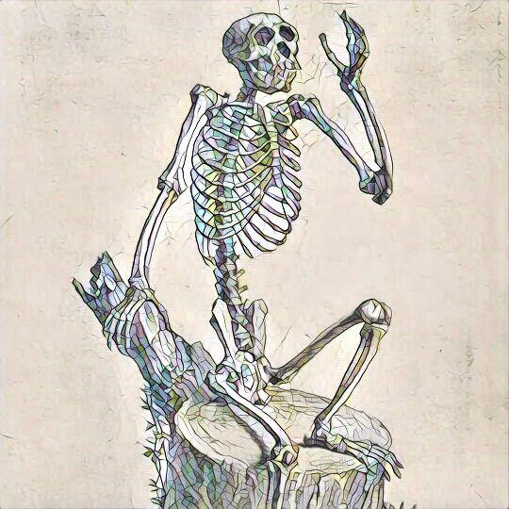
My goal is to synthesize and simplify noteworthy finds and supporting evidence applicable to massage therapy.
Setting the Groundwork for Evidence Based Practice
Theories and Treatment Strategies
Insight into Clinical Presentation

Slide 3
Setting the Groundwork for Evidence Based Practice

Slide 4
Evidence Based Practice is a process intended to optimize decision-making by emphasizing the use of evidence from well designed research to guide treatments.
Clinical Expertise - Sound decisions requires the clinician to assess the patient’s personal, social, and clinical context and integrate this information with the preferences of the informed patient.
Patient Values - Create a working relationship with the patient - involve the patient in developing the plan of care.
Best Research Evidence - Research's main role is to help guide clinical decisions and to warn of known harm.

Slide 5
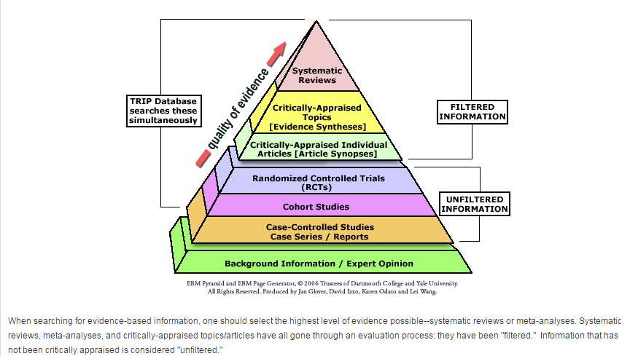
Evaluating Scholarly Articles
Users Beware – in this age of ‘new media’ it is important to be able to critically evaluate information.
The CAARP method is one tool that can be used to evaluate materials.
Currency - Is the information current?
Authority - Who are the authors and what are their qualifications?
Accuracy - Where does that information come from and is it supported by evidence?
Relevance - Does the information relate to your topic?
Purpose - Are the author’s intentions clear?

Slide 6

PubMed is the largest medical database, it has many functions that will help you narrow down your search.
Common PubMed Searches by Keyword
• Musculoskeletal Pain
• Massage Therapy
• Manual Therapy
• Sports Massage
Journals
• British Journal of Sports Medicine
• International Journal of Massage & Bodywork
• Journal of Bodywork and Movement Therapies
• Journal of Orthopaedic & Sports Physical Therapy
• Musculoskeletal Science & Practice

Slide 7
Theories and Treatment Strategies

Slide 8
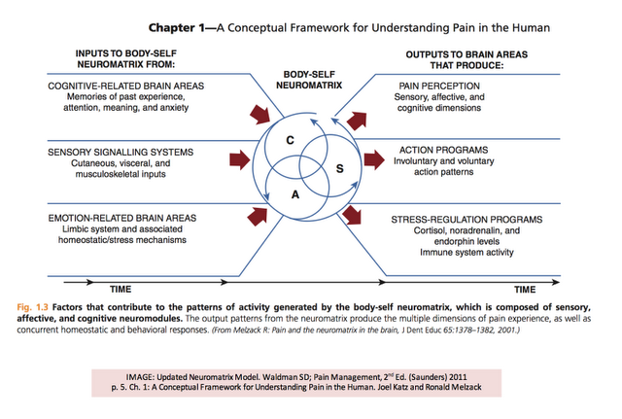
Definition of Pain
The International Association for the Study of Pain (IASP) describes the Experience of Pain as:
“an unpleasant sensory and emotional experience associated with actual or potential tissue damage”

Slide 9
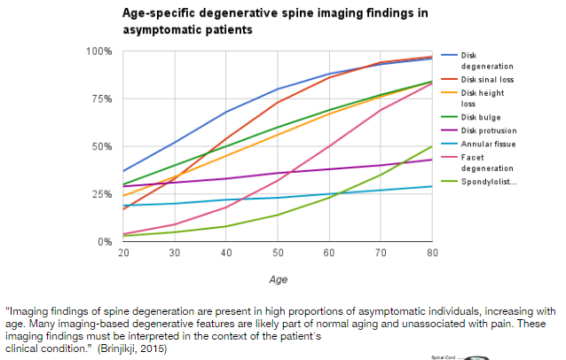
Biopsychosocial Framework
The biopsychosocial framework refers to the interaction of biological, psychological, and social influences which contribute to pain and disability.
The value of an biopsychosocial model is that it acknowledges degenerative tissues does not always correlate to pain, the experience of pain may be influenced by:
Stress
Inflammation
Mood
Sleep
Fatigue
Activity Levels
etc...

Slide 10
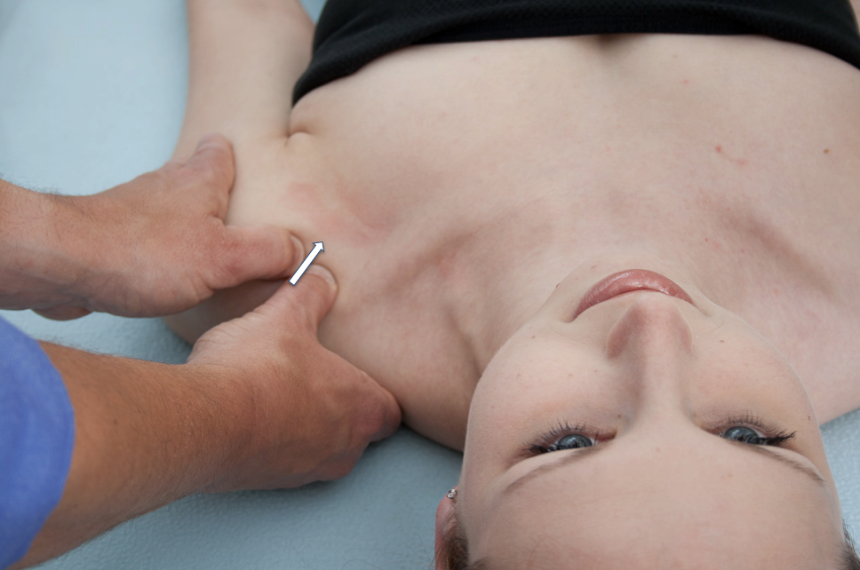
Sports massage is a clinically-oriented multi-modal approach based on a biopsychosocial framework and on the three pillars of evidence based practice.
Swedish Techniques
Triggerpoint Therapy
Thai Massage
Craniosacral Therapy
Sports Massage
Myofascial Release
Active Release
Joint Mobilization
Neurodynamics
Cupping
Acupuncture/Electroacupuncture
Bracing
Taping
IASTM
Shockwave
Cocacoid Ligaments Technique
Robert Libbey, RMT
Ligamentous Articular Strain Technique

Slide 11
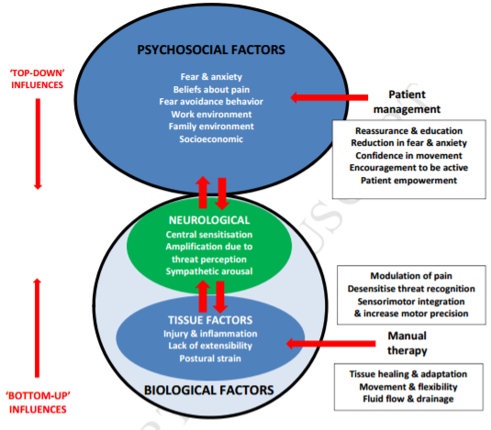
A biopsychosocial framework puts into context the interconnected and multidirectional interaction between: physiology, thoughts, emotions, behaviors, culture, and beliefs.
• Neurodynamics - “A clinical concept that uses movement (1) to assess increased mechanosensitivity of the nervous system; and (2) to restore the altered homeostasis in and around the nervous system.” - Grieve's Modern Musculoskeletal Physiotherapy.
• Mechanotherapy - "Any intervention that introduces mechanical forces with the goal of altering molecular pathways and inducing a cellular response that enhances tissue growth, modeling, remodeling, or repair.” - Thompson et al. 2016.
• Contextually Aided Recovery - The way we present ourselves and present our techniques is tied to clinical outcomes, the magnitude of a response may be influenced by mood, expectation, and conditioning.
• Social Touch - Social grooming helps modulate the activity of neural circuits important for maintaining resting state. This reduced physiological and behavioural reactivity to stressors results in improved mood/affect.
• Neuromodulation - Input from afferent sensory neurons can help ease aches and pain through a myriad of peripheral and central processes.
• Neuroplasticity - Touch can help sharpen the image of the self in our body maps.
Fryer, G. (2017). Integrating osteopathic approaches based on biopsychosocial therapeutic mechanisms. International Journal of Osteopathic Medicine.

Slide 12
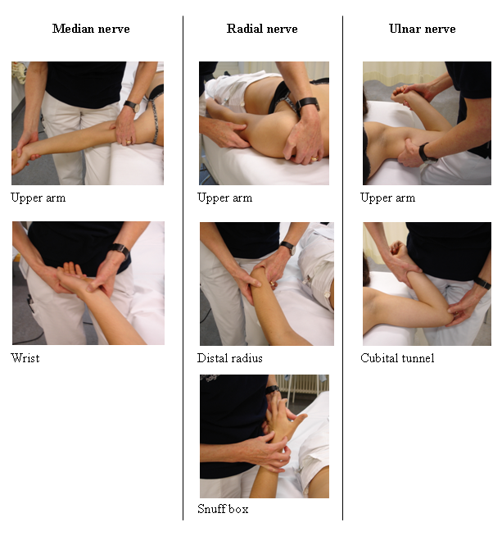
Neurodynamics - “A clinical concept that uses movement (1) to assess increased mechanosensitivity of the nervous system; and (2) to restore the altered homeostasis in and around the nervous system.”
Irritated nerves release neuropeptides- Neurogenic inflammation is generated by the release of inflammatory substances from the sensory axons. Furthermore, in response to persistent nociceptive bombardment, the dorsal root ganglion will release substance P and CGRP antidromically into the peripheral tissue.
Neuroinflammation may explain widespread symptoms in patients with entrapment neuropathies- remote immune-mediated inflammation depending on the degree of compression.
Attenuating intraneural edema - Massage therapy may diminish intraneural edema by mobilizing neural tubes “neural mobilization techniques may promote a healthy nerve environment by improving axonal transport and blood flow, and reducing detrimental chemical and mechanical components resulting from intraneural edema” (Gilbert et al. 2015)
Gilbert et al. (2015). Effects of simulated neural mobilization on fluid movement in cadaveric peripheral nerve sections. Journal of Manual & Manipulative.
Schmid et al. (2009). Reliability of clinical tests to evaluate nerve function and mechanosensitivity of the upper limb peripheral nervous system. BMC Musculoskeletal Disorders.

Slide 13
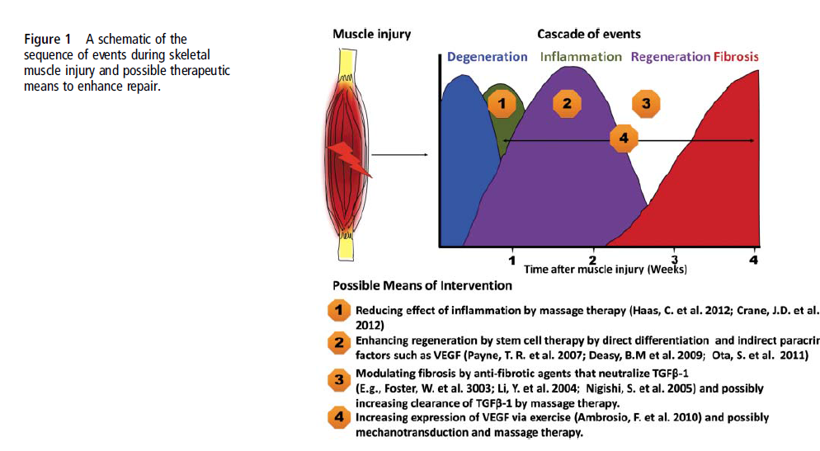
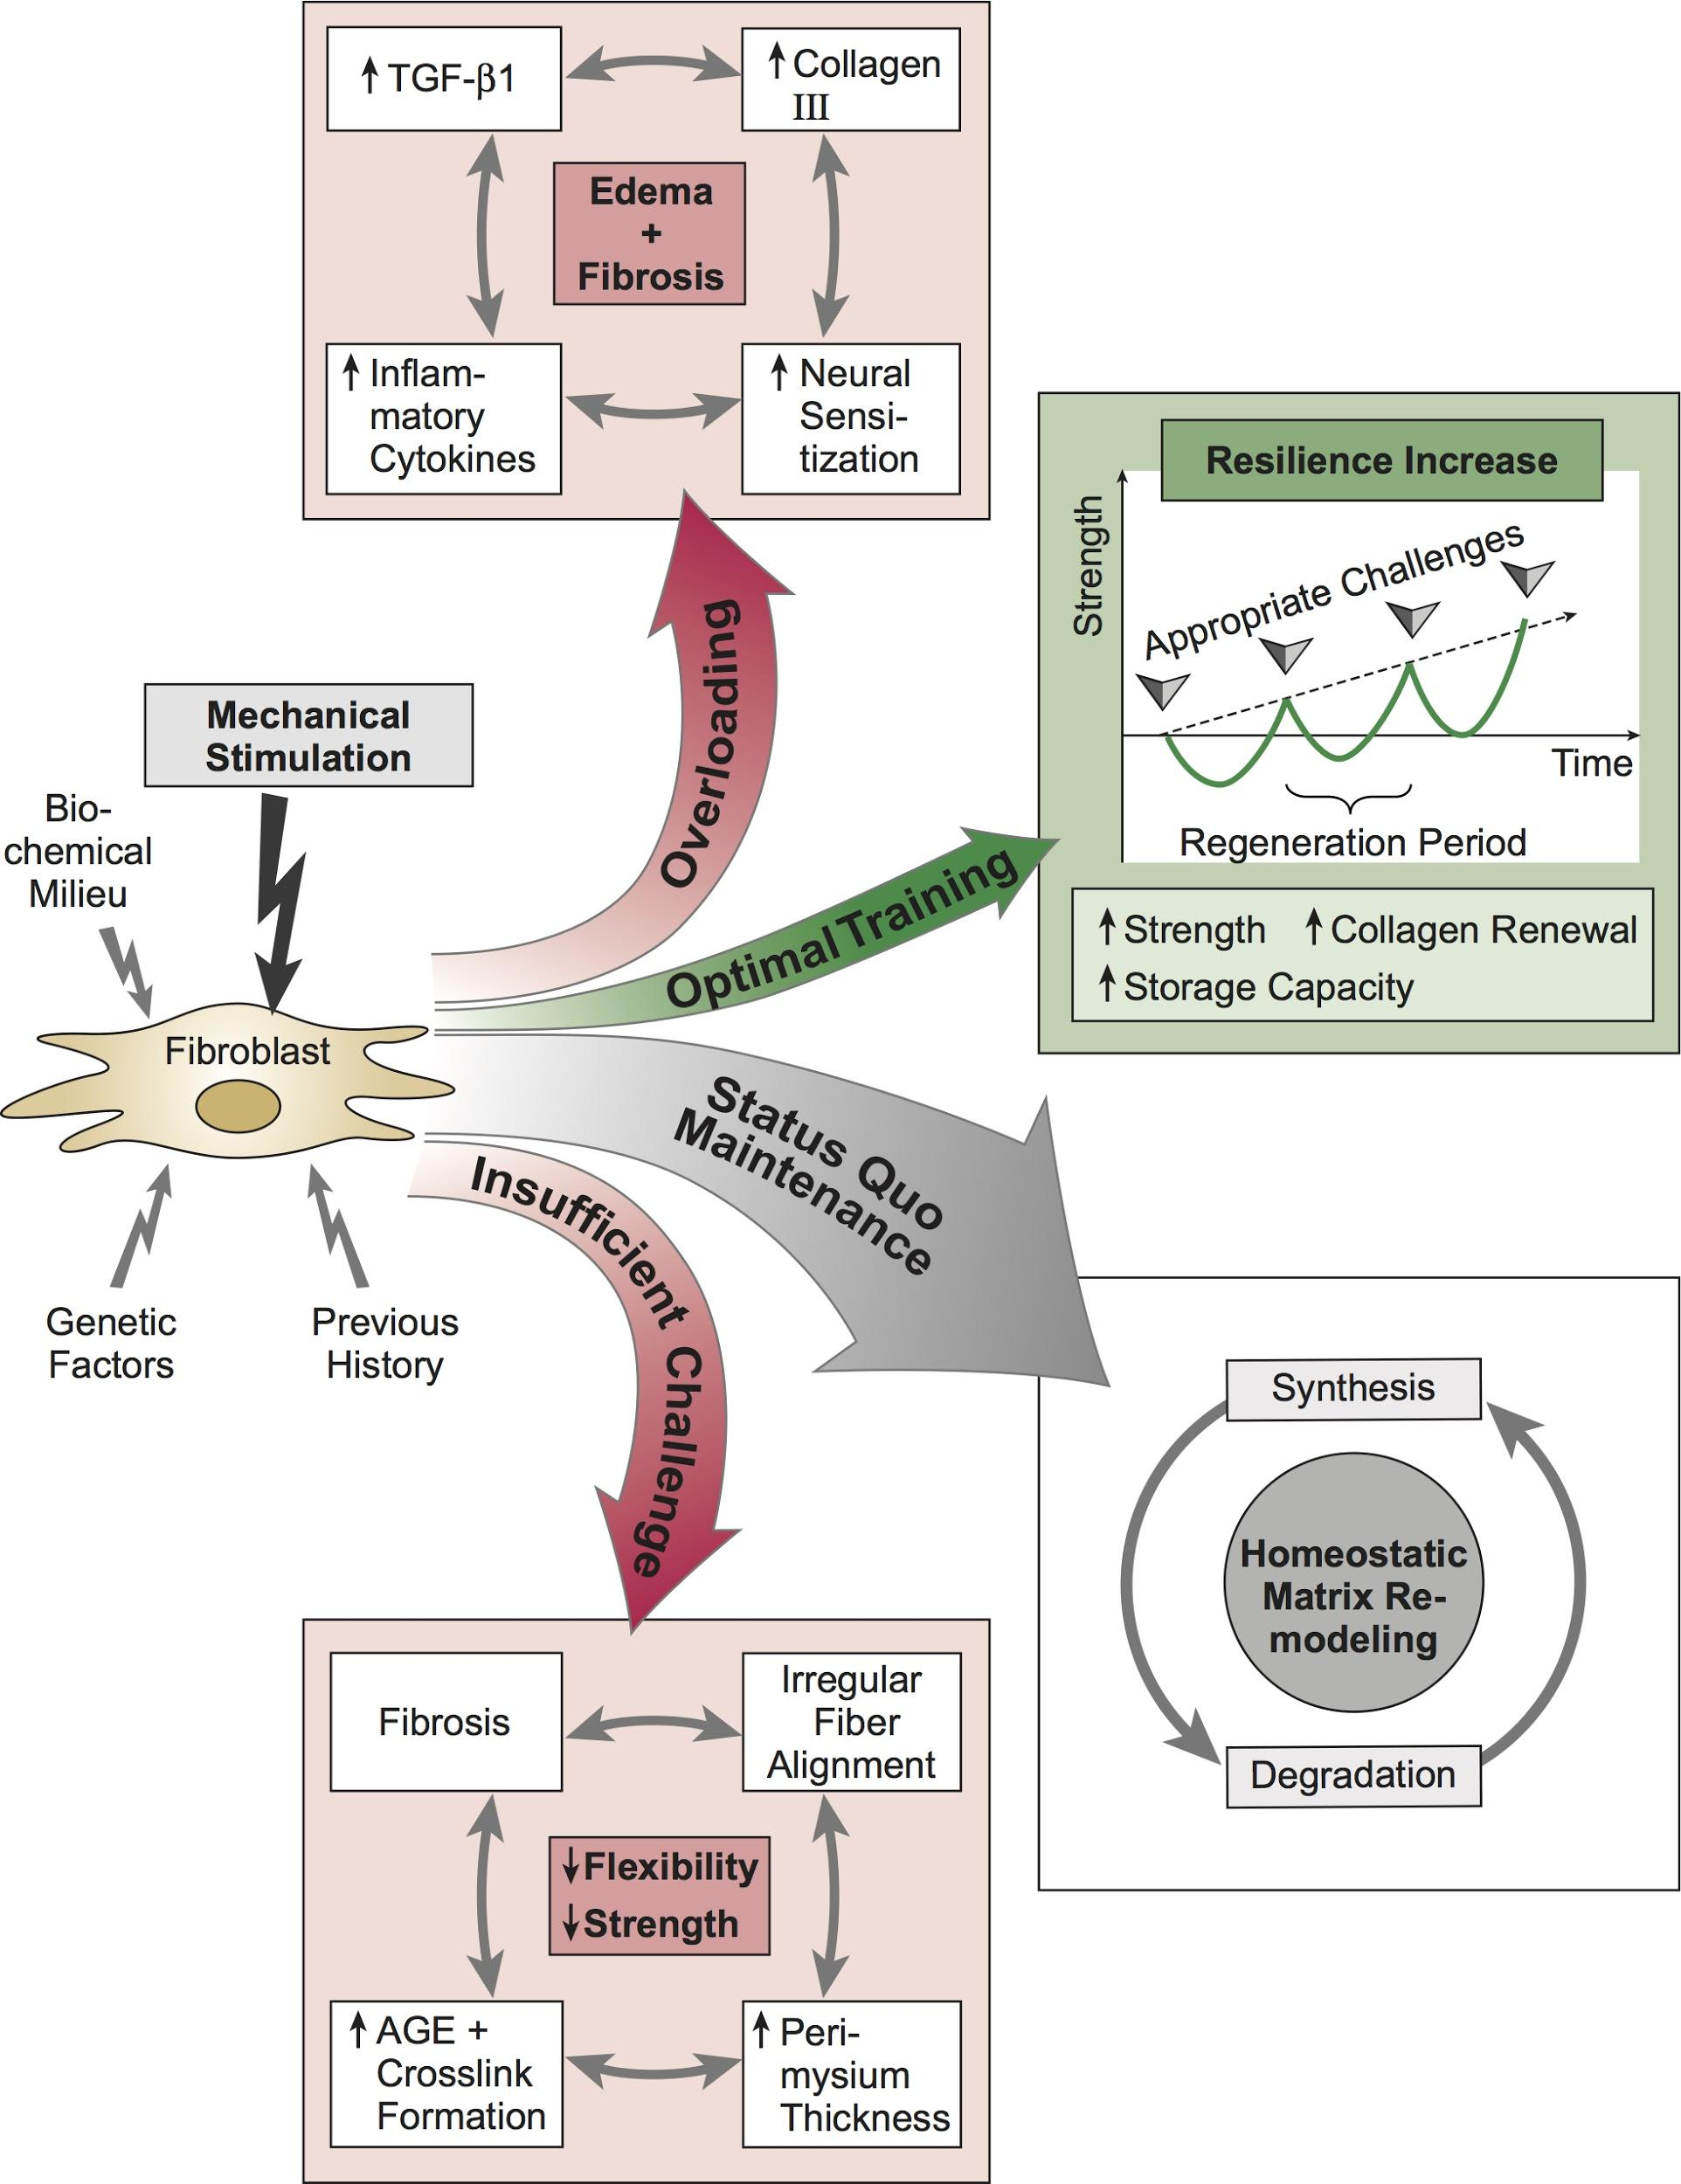
Mechanotherapy - “Any intervention that introduces mechanical forces with the goal of altering molecular pathways and inducing a cellular response that enhances tissue growth, modeling, remodeling, or repair.”
TGF-β1 - Shear force may attenuate TGF-β1 induced fibroblast to myofibroblast transformation (Bove et al. 2016).
Fibroblast - Trigger fibroblasts to express pro-/anti-inflammatory cytokines (Zein-Hammoud et al. 2015).
Macrophage - Prompting the transition of M1 macrophages into the M2 macrophages which play a role in tissue remodeling, immune regulation and phagocytic activity. (Bove et al. 2017, Waters-Banker et al. 2014).
Inflammation - Effect on signaling pathways may influence pain and the sensation of soreness (Crane et al. 2012).
Best et al. (2013). Stem cells, angiogenesis and muscle healing: A potential role in massage therapies? British Journal of Sports Medicine.
Davies Law - Attribution - www.fascialnet.com

Slide 14
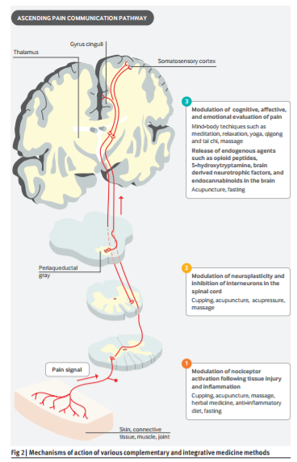
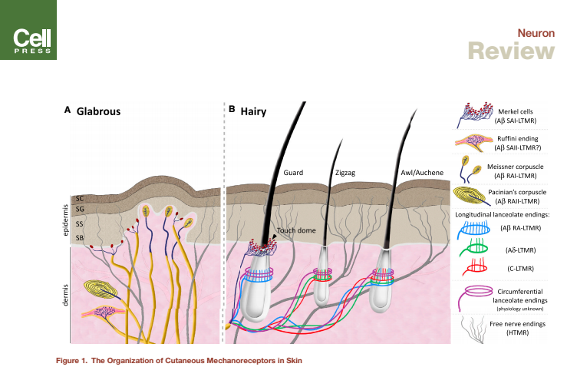
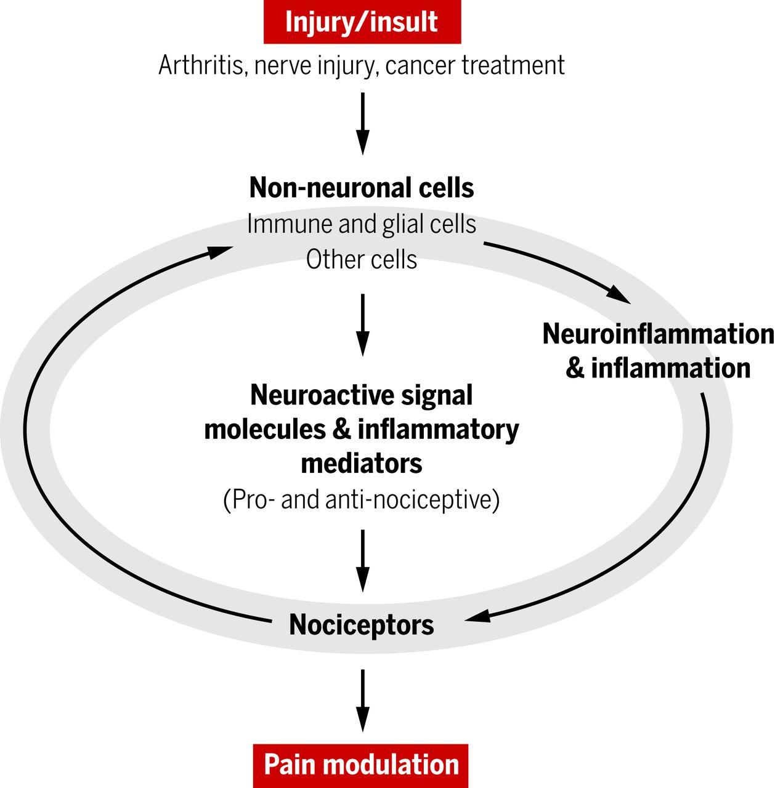
Neuromodulation - Input from afferent sensory neurons can help ease aches and pain through a myriad of peripheral and central processes. MT to areas rich in specialized sensory receptors: muscle spindles, golgi tendon organs, Paciniform and Ruffini’s receptors and free nerve endings.
Abraira et al. (2013). The Sensory Neurons of Touch. Neuron.
Chen et al. (2017). Management of chronic pain using complementary and integrative medicine. BMJ.
Ji et al. (2016). Pain regulation by non-neuronal cells and inflammation. Science

Slide 15
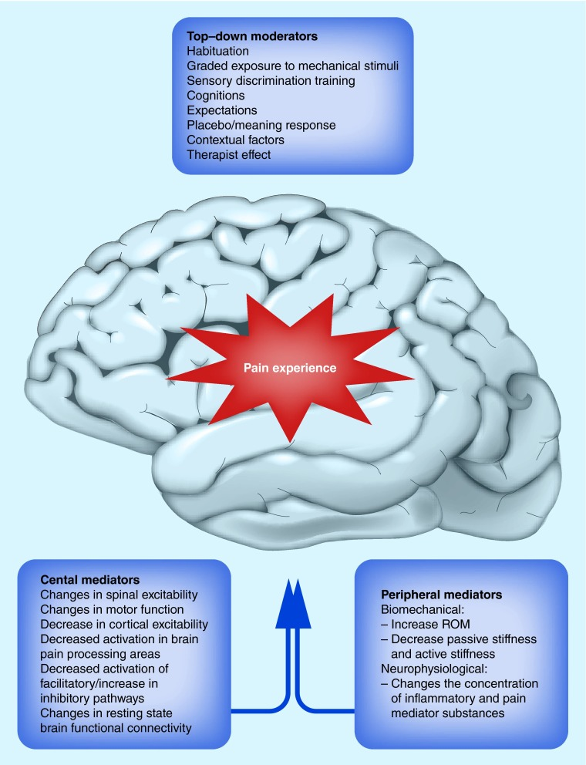
Contextually Aided Recovery
The Placebo Response
Psychosocial factors influence patient reported outcomes - The reduction of anxiety/stress to “optimum” levels seems to cascade several secondary effects (Moyer 2004).
The Social Touch Hypothesis
C-tactile afferent stimulation may mediate oxytocin release - non-noxious, stimulation of cutaneous somatosensory nerves has been shown to trigger oxytocin release and is associated with reduced physiological and behavioural reactivity to stressors (Walker et al. 2017)
Moyer et al. (2004). A meta-analysis of massage therapy research. Psychol Bull.
Timpka et al (2017). Preparticipation predictors for championship injury and illness. Br J Sports Med.
Walker et al. (2017). C-tactile afferents: Cutaneous mediators of oxytocin release during affiliative tactile interactions? Neuropeptides.
Bishop (2015). What effect can manual therapy have on a patients’s pain experience

Slide 16
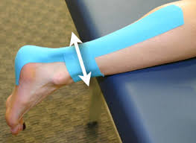
Kinesiotape
Evidence of efficacy is mostly anecdotal, but there are randomized controlled clinical trials showing improvements in pain and disability for:
Back pain (Al-Shareef et al. 2016, Kelle et al. 2016)
Patellofemoral pain (Song et al. 2015 & Song et al. 2017)
Postoperative knee pain (Chan et al. 2017)
Proposed mechanism of action include:
Improved Proprioception
Gate Control - Sensory input to large diameter mechanosensitive nerve fibers helps alleviate pain by reducing nociceptive traffic into the CNS
Sympathetic Vascular Reflex - The application of tape facilitates tissue perfusion and lymphatic flow through a sympathetic vascular reflex

Slide 17
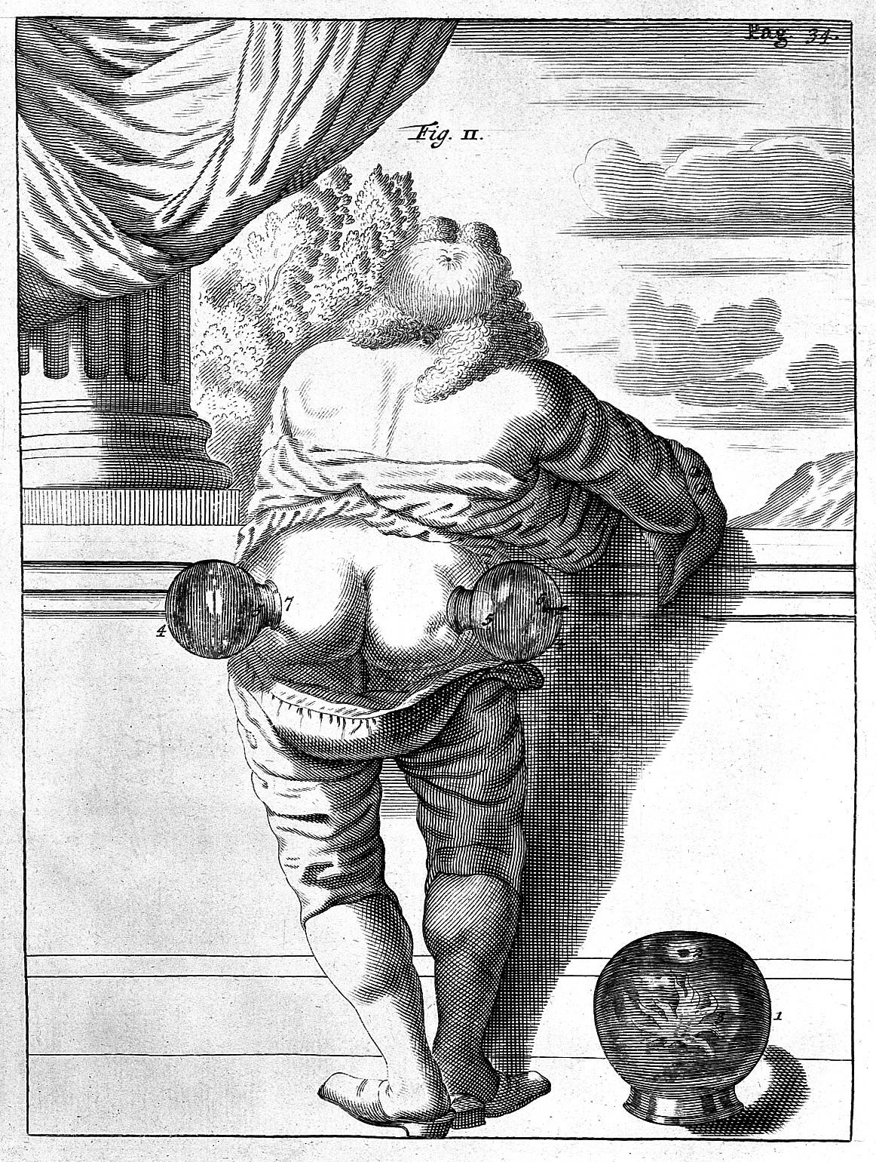
Cupping
The use of cupping originated in a pre-scientific era (3000 B.C.E.) and much of the reasoning once used to explain the effects do not make sense in the light of what we know today.
Proposed Mechanisms of Action Include:
•Contextually Aided Recovery - Cupping serves as a comforting social interaction
•Neuromodulation - Cupping stimulates mechanosensitive nerve fibers (Aβ, Aδ and C)
•Mechanotherapy - Cupping mechanically stretches the skin and underlying soft tissue

Slide 18
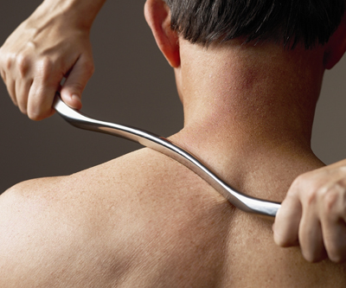
Instrument Assisted Soft Tissue Massage
Instrument Assisted Soft Tissue Mobilization (IASTM) is a technique that uses hand held tools to stimulate mechanoreceptors and impart a mechanical stimulus to the tissues.
The rationale for using IASTM and how it’s implemented depends on the underlying pathology.
IASTM devices may be made from different materials (wood, stone, jade, steel, ceramic, resin)
Cheatham et al. (2016). The efficacy of instrument assisted soft tissue mobilization: a systematic review. J Can Chiropr Assoc.

Slide 19
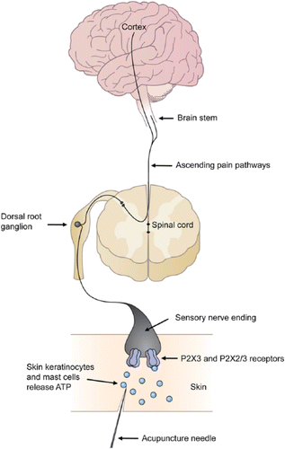
Acupuncture
“Acupuncture is a translation of 针刺术 (zhen ci shu in Chinese pin yin) or in short 针 (zhen), and is literally equivalent to the term ‘needling’ or ‘needling technique’. “Based on the traditional and official definition, the term acupuncture refers to the actual insertion of a needle (usually a solid needle) into the body.” (Fan et al. 2016. Dry needling is acupuncture. Acupunct Med.)
In medical acupuncture needle insertion is based on an understanding of anatomy and neurophysiology. Preferential sites are associated with areas rich in specialized sensory receptors.
Potential biological pathways by which needling might modulate the experience of pain:
  Endogenous Opioids (Chen et al. 2017)
  The Meaning Response (Moerman et al. 2002)
  Purinergic Signaling (Tang et al. 2016, Sawynok et al. 2016)
  Neuroplasticity (Maeda et al. 2017)
  C tactile Afferents (Chae et al. 2017)
  Mesenchymal Stem Cells (Salazar et al. 2017)
  The Gate Control Theory of Pain (Melzack and Wall 1984)
  Local Changes in Microcirculation (Kaneko et al. 2016)
Tang et al. (2016). Acupuncture-Induced Analgesia. The Neuroscientist.

Slide 20
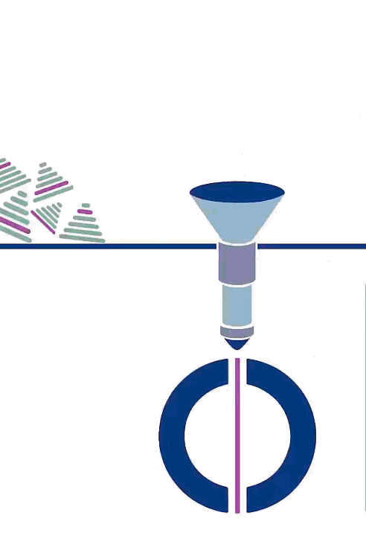
Acupuncture Research has Matured
The College of Massage Therapists of Ontario (CMTO) supports the use of acupuncture within the Massage Therapy Scope of Practice and in accordance with Acupuncture Standard of Practice.
For musculoskeletal pain there is evidence from The Cochrane Collaborative, The American College of Physicians, Canadian Medical Association and other high quality systematic reviews:
Chronic pain (MacPherson et al. 2017, Vickers et al. 2012)
Acute pain (Murakami et al. 2017)
Low back pain (Andronis et al. 2017, Busse et al. 2017, Chou et al. 2017, Qaseem et al. 2017)
Neck pain (Kjaer et al. 2017)
Tension-type headaches (Busse et al. 2017, Linde et al. 2016)
Migraines (Linde et al. 2016, Yang et al. 2016)
Osteoarthritis (Busse et al. 2017, Lin et al. 2016, Woods et al. 2017)

Slide 21
Insight into Clinical Presentation

Slide 22
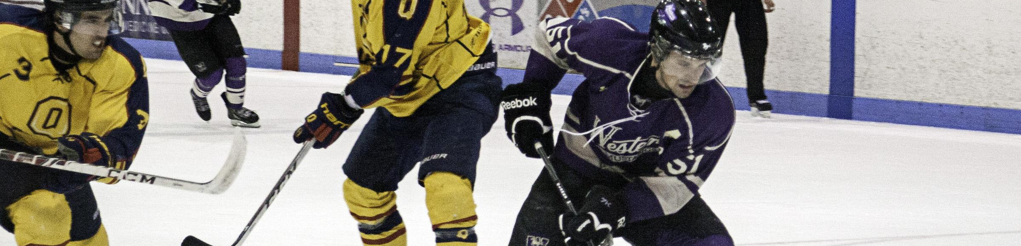
Injury Pattern Recognition
Sports injuries are complex emergent phenomena- Long term athletic development could include the identification of risk profiles.
Working with athletes to develop resiliency by considering interconnected and multidirectional interaction between:
Previous injury
Psychosocial variables
Ongoing pain
Available range of motion

Slide 23
Post-Exertional Recovery Strategies - Due to doping regulations, athletes have strict restrictions of what they can put in their bodies, so naturally they look for alternative ways to ease the pain of overexertion.
Central Governor Model of Fatigue
Inability of lactic acid models of fatigue to adequately explain fatigue (Noakes 2004, Noakes 2012).
Research that has looked at inflammatory markers (Crane et al. 2012).
Researchers at the University of Toronto are looking at inflammatory markers measured in the blood after a massage as well as stress hormones adrenalin, epinephrine, norepinephrine, dopamine to see what effect massage has on those signaling molecules
Massage Therapy
The notion that people feel better after a massage may be enough to warrant the use of post-event massage.
A recent systematic review suggests that short post-event massage (5–12 min) may be for beneficial in improving performance measures (Poppendieck et al. 2016).
Foam Rolling
Evidence suggests that athletes benefit from foam rolling (Beardsley et al. 2015, Cheatham et al. 2015, Schroeder et al. 2015).
Poppendieck et al. (2016). Massage and Performance Recovery: A Meta-Analytical Review. Sports Med
Morales-Alamo et al. (2015). What limits performance during whole-body incremental exercise to exhaustion in humans? J Physiol.
Notes:
Beardsley, C., Škarabot, J. (2015). Effects of self-myofascial release: A systematic review. J Bodyw Mov Ther.
Cheatham SW, Kolber MJ, Cain M, Lee M. THE EFFECTS OF SELF-MYOFASCIAL RELEASE USING A FOAM ROLL OR ROLLER MASSAGER ON JOINT RANGE OF MOTION, MUSCLE RECOVERY, AND PERFORMANCE: A SYSTEMATIC REVIEW. Int J Sports Phys Ther. 2015
Schroeder AN, Best TM. Is self myofascial release an effective preexercise and recovery strategy? A literature review. Curr Sports Med Rep. 2015
Noakes TD. Fatigue is a Brain-Derived Emotion that Regulates the Exercise Behavior to Ensure the Protection of Whole Body Homeostasis. Front Physiol. 2012 Apr 11;3:82.
https://www.ncbi.nlm.nih.gov/pubmed/22514538
Morales-Alamo D, Losa-Reyna J, Torres-Peralta R, Martin-Rincon M, Perez-Valera M, Curtelin D, Ponce-González JG, Santana A, Calbet JA. What limits performance during whole-body incremental exercise to exhaustion in humans? J Physiol. 2015 Oct 15;593(20):4631-48.
https://www.ncbi.nlm.nih.gov/pubmed/26250346

Slide 24
Post-Exertional Recovery Strategies
Cryotherapy
Cold water immersion versus active recovery on inflammatory cells, pro-inflammatory cytokines, neurotrophins and heat shock proteins after resistance exercise - There was not a significant difference between the two methods (Peake et al. 2017).
Sleep
Sleep is an active state of rebuilding, repair, reorganization and regeneration.
Nutrition
Meditation & Regulated Breathing
Potential benefits of paced slow breathing (Jafari et al. 2017).
Mindfulness meditation - a form of meditation that has been adapted from Vipassana and focuses on being in the present moment.
Transcendental meditation is mantra meditation where a word or sound is repeated to aid concentration. (Apps - Headspace and Calm)
Peake et al. (2017). The effects of cold water immersion and active recovery on inflammation and cell stress responses in human skeletal muscle after resistance exercise. J Physiol,
Notes:
Jafari, H., Courtois, I., Van den Bergh, O., Vlaeyen, J.W., Van Diest, I. (2017). Pain and respiration: a systematic review. Pain.
https://www.ncbi.nlm.nih.gov/pubmed/28240995

Slide 25
Postoperative Care
Postoperative Care - Research is still in its infancy but there is evidence to suggest that in addition to managing pain and discomfort, massage therapy may optimize post-surgical function and prevent joint stiffness.
Scar Management - As little as 10 minutes of massage per day, with either a topical agent or lubricant may go a long way in decreasing the thickness of scar. It may also shorten the time required for formation of a mature scar tissue.
Tissue Healing - The mechanisms by which massage therapy interrupt the sequelae of pathological healing is most likely not in a single unified response, but as a collection of interconnected adaptive responses within the neuroimmune system and soft tissue structures.
Notes:
Bijlard, E., Uiterwaal, L., ... Huygen, F.J. (2017). A Systematic Review on the Prevalence, Etiology, and Pathophysiology of Intrinsic Pain in Dermal Scar Tissue. Pain Physician.
https://www.ncbi.nlm.nih.gov/pubmed/28158149

Slide 26
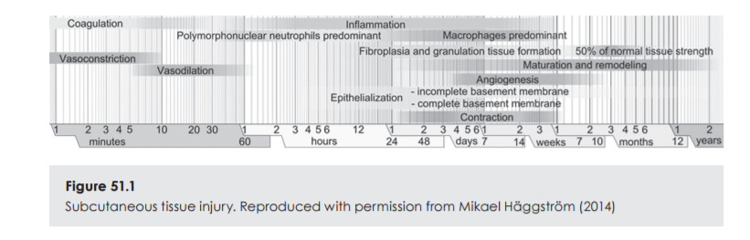
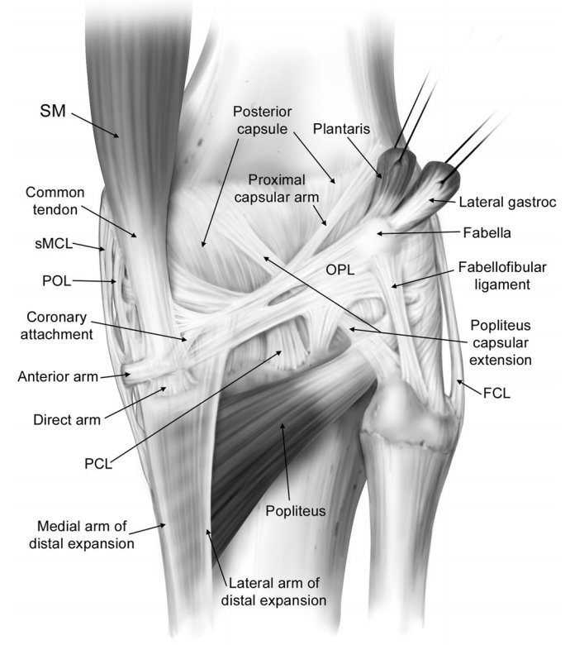
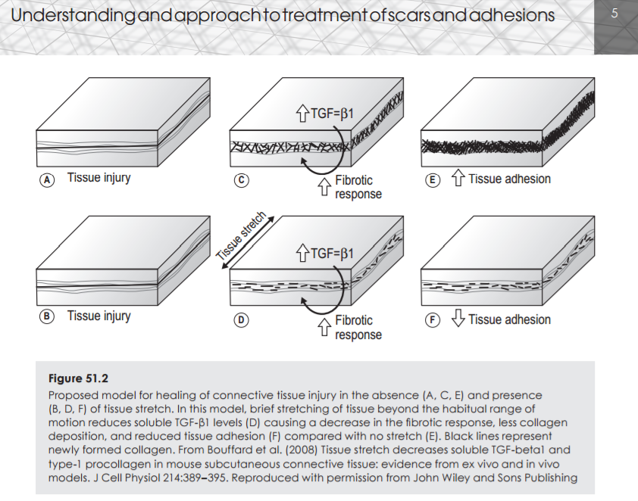
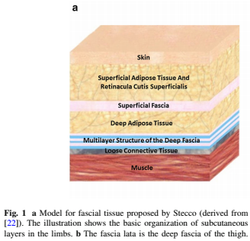
Chapelle, S. (2017). Understanding and Approach to Treatment of Scars and Adhesion.
Tissue Healing
TGF-β1 - As a therapeutic intervention massage therapy has the potential to attenuate TGF-Β1 induced fibroblast to myofibroblast transformation (Best et al. 2013, Bove et al. 2016).
Macrophage - Prompting the transition of M1 macrophages into the M2 macrophages which play a role in tissue remodeling, immune regulation and phagocytic activity. (Bove et al. 2017, Waters-Banker et al. 2014).
Notes:
LaPrade et al. (2007). The anatomy of the posterior aspect of the knee. An anatomic study. J Bone Joint Surg Am.

Slide 27
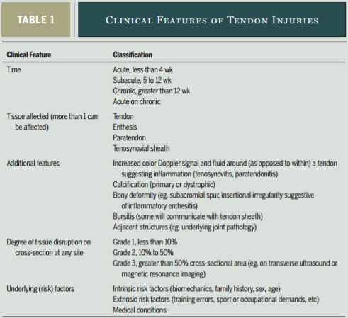
Tendinopathy
Tendinopathy is a broad term encompassing painful conditions occurring in and around tendons in response to overuse.
Tendons are susceptible for injury in areas where compressed around bone
Multimodality options (relative rest, activity modifications) should be considered as the first line treatment of tendinopathies.
Inflammation - Exists but not the primary driver of pathology
Symptom modification - Massage as an adjunctive therapy to relieve pain and reduce muscle inhibition.
Scott et al. (2015). Tendinopathy: Update on Pathophysiology. JOSPT.
Notes:
Scott A, Backman LJ, Speed C. (2015). Tendinopathy: Update on Pathophysiology. J Orthop Sports Phys Ther.
https://www.ncbi.nlm.nih.gov/pubmed/26390273

Slide 28
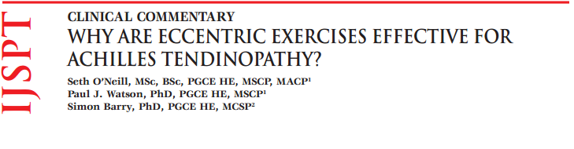
Loading Programs
Concentric – evidence that this may be effective
Eccentric – best treatment available - “eccentric loading results in positive changes in ankle kinematics, lower-limb stiffness, and agonist/antagonist muscle activity ... possibly protecting the tendon from excessive load and providing an opportunity to heal” (Debenham et al. 2017)
Isometrics – give some short-term pain relief and cortical inhibition, and may be good for reactive/compressive tendinopathy
Heavy slow resistance – seems to be effective in patellar tendinopathy and achilles tendinopathy.
Debenham et al. (2017). Modulation of Stretch-Shortening-Cycle Behavior With Eccentric Loading of Triceps Surae: A Possible Therapeutic Mechanism. J Sport Rehabil.

Slide 29
Myofascial Triggerpoints
Otzi “The Iceman” was discovered in the Alps of Austria - believed to be 5,300 years old had 61 tattoos corresponding with acupuncture points and myofascial trigger points.
Similar phenomena have been independently identified by many different prehistoric cultures in Europe, Africa and Asia.
From a clinical perspective, myofascial trigger points describe a phenomenon — aching spots, the issue is that there is still uncertainty on the subject of triggerpoints (eg. what they are and the subjective nature of their identification).
Pain distribution from trigger points are a useful sign that helps clinicians investigate pain patterns, even if our explanations about what a triggerpoint is has changed.
Triggerpoint are often experienced in areas associated with areas rich in specialized sensory receptors. It is a challenge to discern whether it is a site of primary hyperalgesia (site of tissue pathology) and secondary hyperalgesia (referred pain). There is evidence of inflammatory chemicals in the interstitial tissues around trigger points, it is unknown whether the presence of inflammatory chemicals can be attributed to a CNS origin or a peripheral origin (Shah et al 2015).

Slide 30
Myofascial Triggerpoints
Questions about trigger points remain to be answered; sore spots exist, but their etiology is still not well understood, hypothesis include:
Cinderella Hypothesis - low-level, continuous muscle contractions overload tissues and makes “Cinderella” fibers susceptible to calcium dysregulation and subsequently sarcomere contracture (Bron et al. 2012).
Expanded Integrated Hypothesis - the zone around a MTrP seems to be in an ischemic state resulting in a shortage of glucose and oxygen for metabolism and subsequent sarcomere contracture (Simons 2008). It is proposed that improved perfusion and oxygen delivery to the muscle, encourages the removal of cellular exudates and drainage of metabolic waste (Moraska et al. 2013).
Neuroinflammation - Neurogenic inflammation is generated by the release of inflammatory substances from the axon, resulting in a lower the threshold for depolarization (Quintner et al. 2015).
Central Sensitization - Several studies support the hypothesis that TrP can induce central sensitization, and appropriate TrP treatment reduces central sensitization. In contrast, preliminary evidence suggests that central sensitization can also promote TrP activity, although further studies are needed. (Fernández-de-las-Peñas et al. 2014).
Shah et al. (2015). Myofascial Trigger Points Then and Now: A Historical and Scientific Perspective. Pm&r.
Notes:
Fernández-de-las-Peñas C, Dommerholt J. (2014). Myofascial trigger points: peripheral or central phenomenon? Curr Rheumatol Rep.
https://www.ncbi.nlm.nih.gov/pubmed/24264721
“The integrated TrP hypothesis postulates that in myofascial pain motor endplates release excessive acetylcholine, which is evidenced histopathologically by the presence of sarcomere shortening” *(Bron et al 2012)

Slide 31
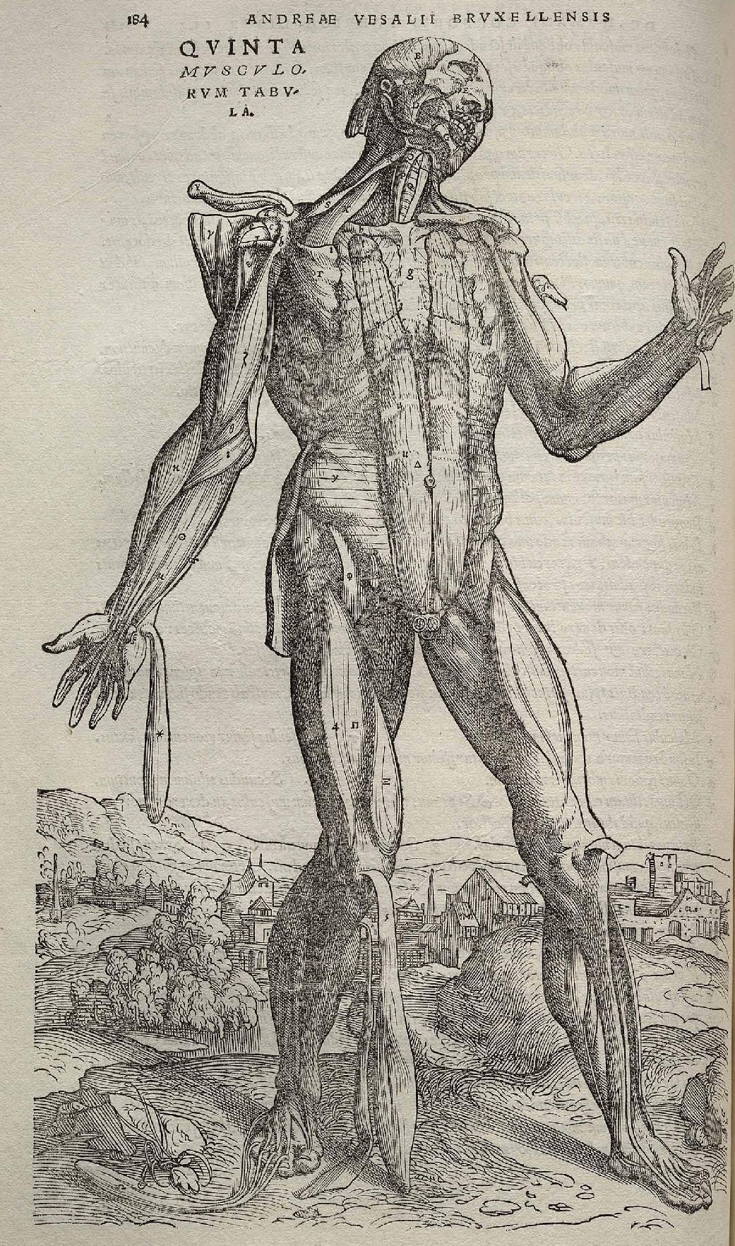
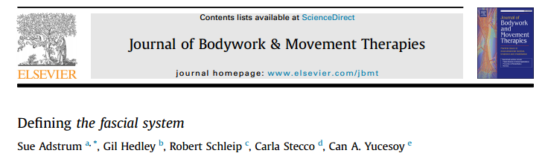
"The fascial system interpenetrates and surrounds all organs, muscles, bones and nerve fibers, endowing the body with a functional structure, and providing an environment that enables all body systems to operate in an integrated manner."
Myofascial transitions have been described and verified by independent researchers (Wilke et al. 2016):
Superficial back line- (plantar fascia-gastrocnemius; gastrocnemius-hamstrings; hamstrings-lumbar fascia/erector spinae)
Back functional line- (latissimus-lumbar fascia; lumbar fascia-gluteus maximus; gluteus maximus-vastus lateralis)
Front functional line- (pectoralis major-rectus abdominis; rectus abdominis-adductor longus)
Connections Exist Throughout The Body

Slide 32
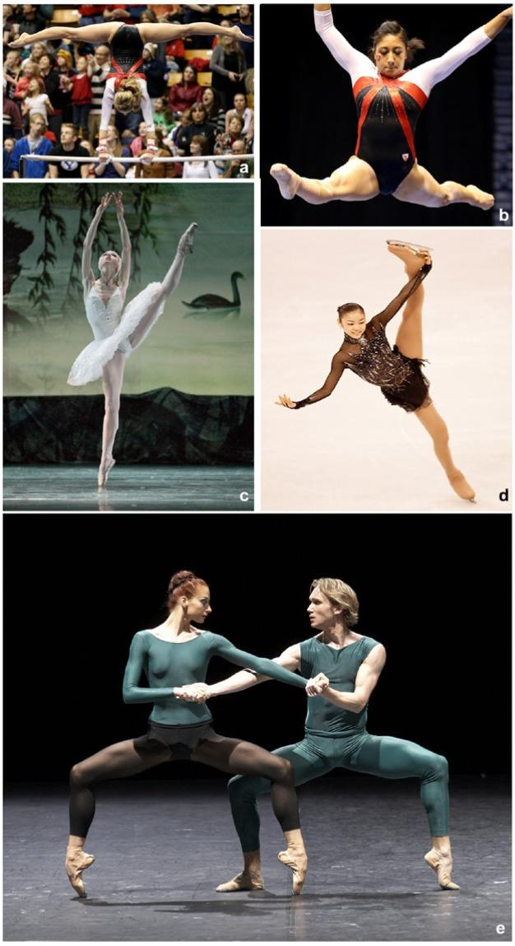
Joint Hypermobility
“Approximately 3% of the general population is believed to have joint hypermobility syndrome, but despite this high prevalence, due to lack of awareness, heterogeneity of clinical presentation, and reliance on physical examination for diagnosis, it is largely overlooked by primary care physicians as well as by specialists.”
Kumar et al. (2017). Joint Hypermobility Syndrome: Recognizing a Commonly Overlooked Cause of Chronic Pain. The American Journal of Medicine.
Notes:
Kumar, B., Lenert, P. (2017). Joint Hypermobility Syndrome: Recognizing a Commonly Overlooked Cause of Chronic Pain.
https://www.ncbi.nlm.nih.gov/pubmed/28286166
Weber, A.E., Bedi, A., Tibor, L.M., Zaltz, I., Larson, C.M. (2015). The Hyperflexible Hip: Managing Hip Pain in the Dancer and Gymnast. Sports Health.

Slide 33
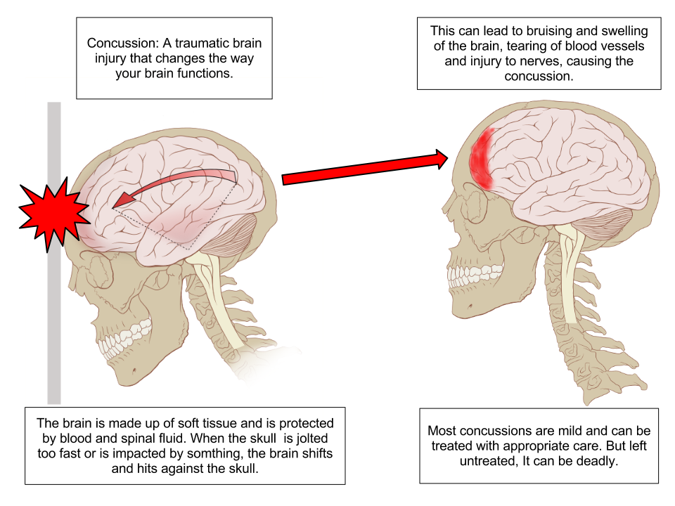
Concussions
“A concussion is a brain injury caused by a complex physical process affecting the brain, induced by biomechanical forces.”

Slide 34
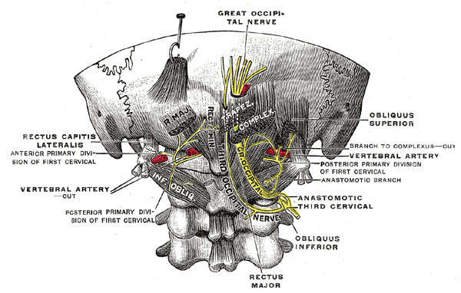
Concussion and Post-Concussion Syndrome
We aren't treating the concussion itself but instead, helping relieve associated factors:
Manual Therapy to the Cervical Spine: Treatment program based on patient-specific assessment findings and patient tolerance.
Patient Education: The most important part of the health care professional’s involvement in managing concussions; ongoing education and management strategies.

Slide 35
Concussion: General Consensus
Relative Rest - “A brief period (24-48 hours) of cognitive and physical rest is appropriate for most patients. Following this, patients should be encouraged to gradually increase activity.” (Schneider et al. 2017)
Long-term Effects - “Multiple concussions appear to be a risk factor for cognitive impairment and mental health problems in some individuals. More research is needed to better understand the prevalence of chronic traumatic encephalopathy and other neurological conditions and diseases, and the extent to which they are related to concussions and/or repetitive neurotrauma sustained in sports.” (Manley et al. 2017)
Whiplash Associated Disorder- “Concussion is typically defined as a mild brain injury, and yet the brain is unlikely to be the only source of persistent post-concussion symptoms. Concurrent injury to the cervical spine in particular is acknowledged as a potential source of common persistent symptoms such as headache, dizziness and neck pain.” (Kennedy et al. 2017)
Kennedy et al. (2017) Clinical characteristics and outcomes of treatment of the cervical spine in patients with persistent post-concussion symptoms: A retrospective analysis, Musculoskeletal Science and Practice.
Manley et al. (2017). A systematic review of potential long-term effects of sport-related concussion. Br J Sports Med.
Schneider et al. (2017). Rest and treatment/rehabilitation following sport-related concussion: a systematic review. Br J Sports Med.

Slide 36
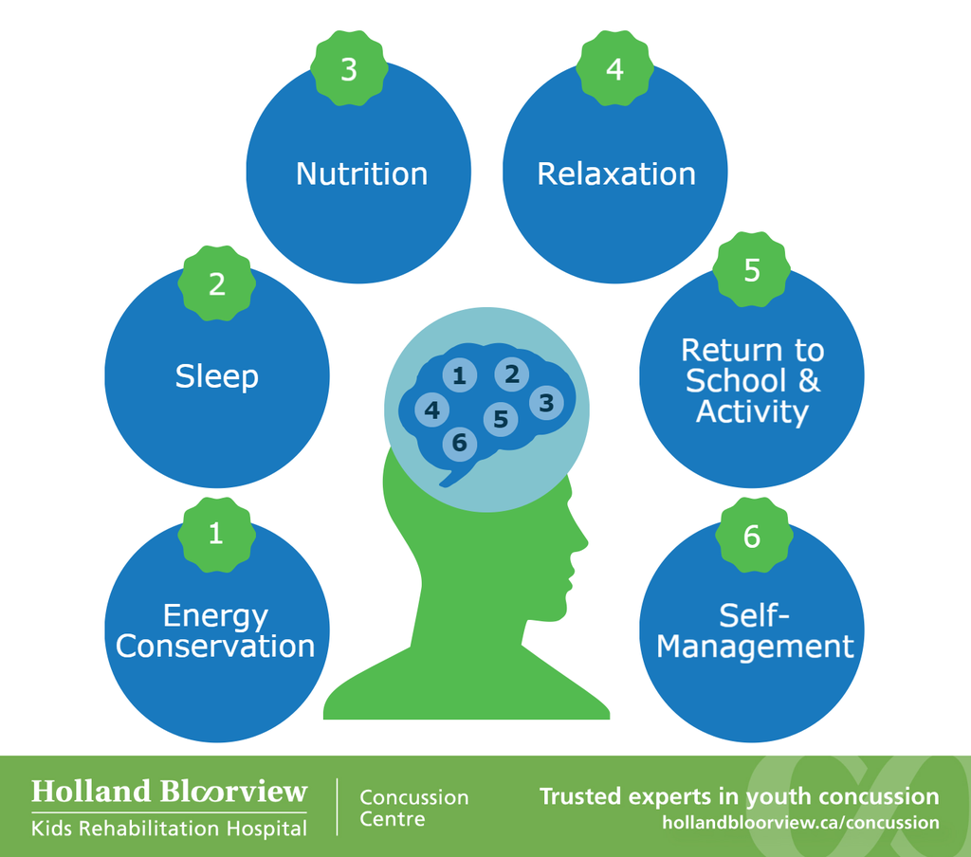
Self Management Tools
Changes in the management of concussions have occurred
No objective measures to diagnose concussion, concussion is biochemical in nature
Start low and go slow... Time to heal is variable, the severity of injury is not known until symptoms resolve
Baseline testing lead to improved concussion management
Whiplash injuries often accompany concussions, treating whiplash symptoms can often improve outcomes in patients who suffer a concussion
What works for one person may not work for others

Slide 37
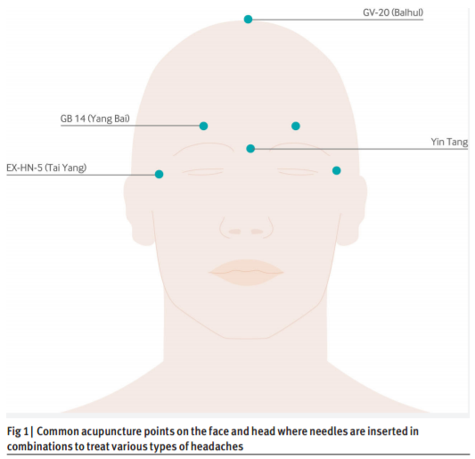
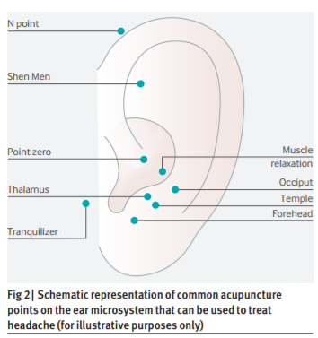
Headaches and Migraines
The goal is to decrease the individual’s headache frequency, intensity, duration and acute medication requirements.
Massage Therapy - Treatment focus on the impairments that may be related to or irritating, and dosage is based on patient-specific assessment findings and patient tolerance.
Tension type headaches (Ferragut-Garcías et al. 2017, Nahin et al. 2016, Varatharajan et al. 2016).
Migraines (Chaibi et al. 2011, Happe et al. 2016)
Tinnitus (Michiels et al. 2017)
Auricular Acupuncture - In the ear, tiny fingers of the vagus’s fibers run close to the surface of the skin, studies have explored using stimulation of those fibers
Scalp Acupuncture - Fine needles are placed on the scalp to achieve therapeutic effects
Happy Points
GV-20- Anastomosis: greater occipital nerve, auriculotemporal nerve, supraorbital nerve
GV-24.5- Between eyebrow: Procerus muscle fascial nerve
Shen Men
Point Zero
Millstine et al. (2017). Complementary and integrative medicine in the management of headache. BMJ.
Notes:
Michiels, S., Van de Heyning, P., Truijen, S., Hallemans, A., De Hertogh, W. (2017). Prognostic indicators for decrease in tinnitus severity after cervical physical therapy in patients with cervicogenic somatic tinnitus. Musculoskelet Sci Pract.
https://www.ncbi.nlm.nih.gov/pubmed/28286241

Slide 38
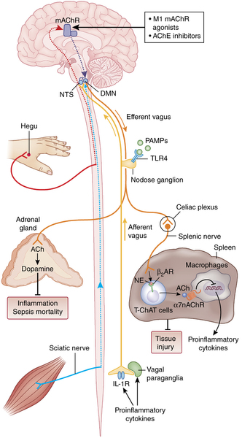
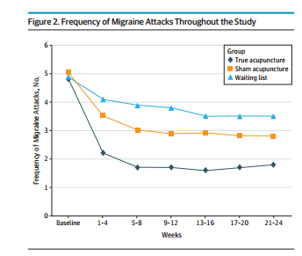
Migraine: Electro-Acupuncture
Linde et al. (2016). Acupuncture for the prevention of episodic migraine. Cochrane Database of Systematic Reviews.
Pavlov et al (2017). Neural regulation of immunity: molecular mechanisms and clinical translation. Nat Neurosci.
Yang et al. (2016). Verum versus sham manual acupuncture for migraine: a systematic review of randomised controlled trials. Acupunct Med.
Zhao et al. (2017). The Long-term Effect of Acupuncture for Migraine Prophylaxis A Randomized Clinical Trial. JAMA Intern Med.

Slide 39
Neck Pain and Whiplash-Associated Disorders (WAD)
For those who suffer from neck pain, massage therapy has been shown to be a non-pharmacological therapeutic intervention that is simple to carry out, economical, and has very few side effects (Bussières et al. 2016, Côté et al. 2016, Nahin et al. 2016, Sutton et al. 2016, Wong et al. 2016)
Although whiplash usually only causes damage to the soft tissues of the neck, physicians may take x-rays to rule out other spinal problems or injuries like bone fractures.
Common Symptoms:
neck complaints of pain, stiffness or tenderness only but no physical signs are noted
neck complaints and the examining finds decreased range of motion and point tenderness in the neck

Slide 40
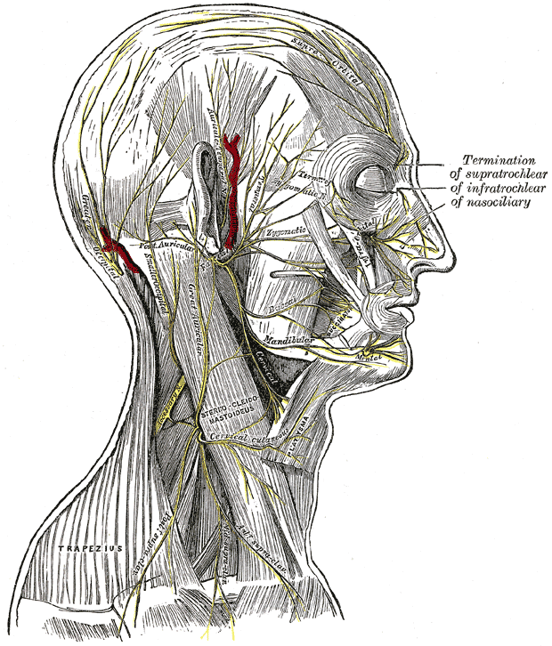
Temporomandibular Disorder
The therapeutic effects of intra-oral and extra-oral massage for the management of temporomandibular dysfunction is supported by multiple systematic reviews (Martins et al. 2016, Randhawa et al. 2016)
Indicators for the assessment and treatment of the TMJ:
Jaw Pain
Ear paint
Tinnitus
Bruxism
Intra-oral work may include:
Masseter
Temporalis tendon
Medial pterygoid muscle

Slide 41
Tools to Preserve & Improve Movement: The Shoulder
Rehabilitation programs that decrease tissue stiffness and improve range of motion have potential clinical implications for injury prevention (Bailey et al. 2015, Zaremski et al. 2017).
A four-week treatment program of manual therapy or dry needling demonstrated a significant improvement in pain pressure threshold, muscle elasticity, and stiffness of neck and shoulder muscles (De Meulemeester et al. 2017)
Four weeks of soft tissue mobilization had an affect on tissue stiffness, shoulder internal rotation and horizontal adduction in baseball players with posterior shoulder tightness (Yamauchi et al. 2016)
Modified cross body stretch and modified sleeper stretch leads to decreased the stiffness of the teres minor and infraspinatus (Umehara et al. 2017)
IASTM with self-stretching significantly reduces ROM risk factors in baseball players with motion deficits (Bailey et al. 2017)

Slide 42
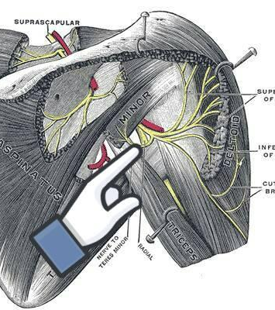
Rotator Cuff Tendinopathy
Management of rotator cuff tendinopathy includes relative rest, modification of painful activities, and an exercise program guided to regain motion and strength (Lewis et al. 2015).
Neurodynamic Movements- Quadrilateral space syndrome involves compression of the axillary nerve and/or the posterior circumflex artery within the quadrilateral space. This space is defined by the teres minor superiorly, long head of the triceps medially, humerus laterally, and teres major inferiorly.
Notes:
Lewis, J., McCreesh, K., Roy, J.S., Ginn, K. (2015). Rotator Cuff Tendinopathy: Navigating the Diagnosis-Management Conundrum. J Orthop Sports Phys Ther.
https://www.ncbi.nlm.nih.gov/pubmed/26390274

Slide 43
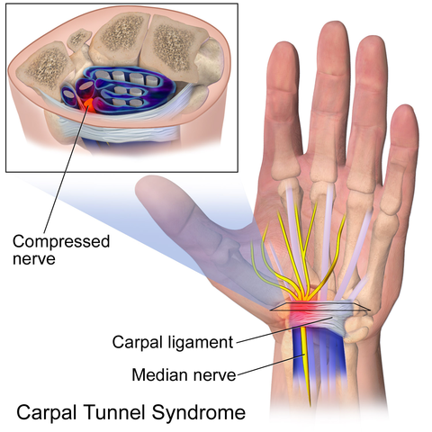
Carpal Tunnel Syndrome
Conservative treatments have shown to improve symptoms, decrease disability and improve function.
For some patients there is no significant differences in pain and functional outcomes at 6 and 12 months between surgery and conservative treatments (Fernández-de-Las-Peñas et al. 2017).
Fernández-de-Las-Peñas et al. (2017). The Effectiveness of Manual Therapy versus Surgery on Self-Reported Function, Cervical Range of Motion and Pinch Grip Force in Carpal Tunnel Syndrome: A Randomized Clinical Trial. J Orthop Sports Phys Ther.
Huisstede et al. (2017). The Effectiveness of Surgical and Post-Surgical Interventions for Carpal Tunnel Syndrome-A Systematic Review. Arch Phys Med Rehabil

Slide 44
Low Back Pain
Recommendations from The Canadian Medical Association (Busse et al. 2017), The American College of Physicians (Chou et al. 2017, Qaseem et al. 2017) and The Mayo Clinic (Nahin et al. 2016) represent a monumental shift in pain management. Physicians, now more than ever are recommending massage therapy and exercise as part of a multi-modal approach for patients suffering from low back pain.
Randomized Controlled Trial of Triggerpoint Compression
A randomized controlled study published in the European Journal of Pain tested the effect of 6 consecutive treatments (3 per week for 2 weeks) - 63 patients with acute low back pain were randomly assigned to one of three groups:
• MTrP group who received compression at MTrPs (N = 23)
• non-MTrP group who received compression at non-trigger points (N = 21)
• another group received superficial massage (N = 19)
Takamoto et al. (2015). Effects of compression at myofascial trigger points in patients with acute low back pain: A randomized controlled trial. Eur J Pain.

Slide 45
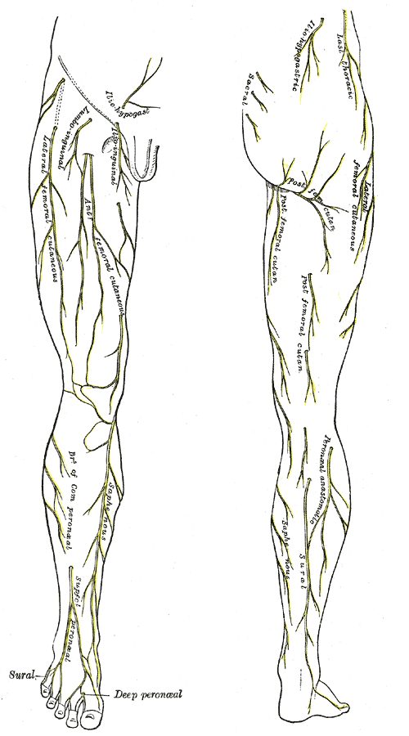
Hip Pain
Hip and Back Connection
Hip abductor as a factor in a patient's knee pain or back pain (Bade et al. 2017. Cooper et al. 2016, Prather et al. 2017)
Posterior Hip Pain:
lumbar spine and femoroacetabular joint referral
sacroiliac joint pathology
piriformis syndrome
proximal hamstring tendinopathy
Lateral Hip Pain:
gluteal tendinopathy and iliotibial band
Anterior Hip Pain
intra-articular (ie, labral tear, osteoarthritis, osteonecrosis)
extra-articular (ie, snapping hip and inguinal disruption [athletic pubalgia]
* Additionally Entrapment neuropathies and myofascial pain should also be considered in each compartment
Battaglia et al. (2016). Posterior, Lateral, and Anterior Hip Pain Due to Musculoskeletal Origin. J Chiropr Med.
Notes:
Bade et al. (2017). Effects of manual therapy and exercise targeting the hips in patients with low-back pain-A randomized controlled trial. J Eval Clin Pract.
Cooper, N.A., Scavo, K.M., ... Sluka, K.A. (2016). Prevalence of gluteus medius weakness in people with chronic low back pain compared to healthy controls. Eur Spine J.
Prather et al. (2017). Hip and Lumbar Spine Physical Examination Findings in People Presenting With Low Back Pain, With or Without Lower Extremity Pain. J Orthop Sports Phys Ther.

Slide 46
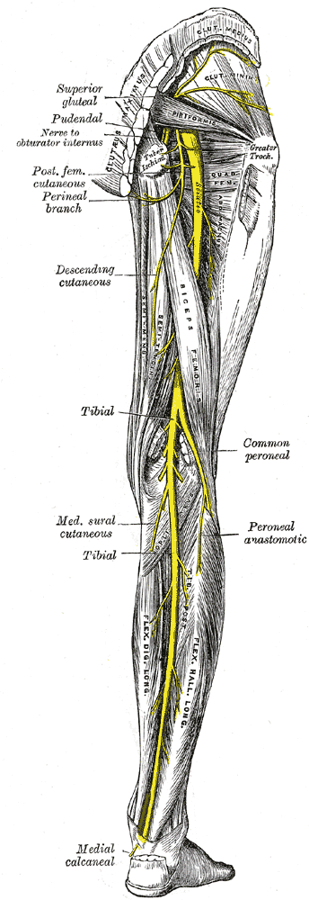
Deep Gluteal Syndrome
Deep gluteal syndrome is characterized by pain in the hip or posterior thigh, this may be caused by entrapment of the sciatic nerve:
The piriformis muscle
Fibrous bands
Gluteal muscles
Quadratus femoris
Hamstring muscles
Gemelli-obturator internus complex
Vascular abnormalities
Space occupying lesion
Carro et al. (2016). Deep gluteal space problems: piriformis syndrome, ischiofemoral impingement and sciatic nerve release. Muscles Ligaments Tendons J.

Slide 47
Greater Trochanteric Pain Syndrome
The diagnosis of GTPS encompasses:
greater trochanteric bursitis
gluteus medius and gluteus minimus tears
snapping hip
Clinical test that may be of value:
FABER test
palpation of the greater trochanter
resisted hip abduction
resisted external derotation test
Hip Pain: Dry Needling vs. Cortisone Injection
Methods
Forty-three participants with Greater trochanteric pain syndrome, were randomly assigned to a group receiving cortisone injections or DN over 6 weeks.
Results
Baseline characteristics were similar in the groups, this indicates non-inferiority of DN vs. cortisone injections. Medication usage (p-value=0.74) was not different between groups at the same time point.
Brennan et al. (2017). Dry Needling Versus Cortisone Injection in the Treatment of Greater Trochanteric Pain Syndrome: A Non-Inferiority Randomized Clinical Trial. J Orthop Sports Phys Ther.
Ganderton et al. (2017). Demystifying the Clinical Diagnosis of Greater Trochanteric Pain Syndrome in Women. J Womens Health (Larchmt).

Slide 48
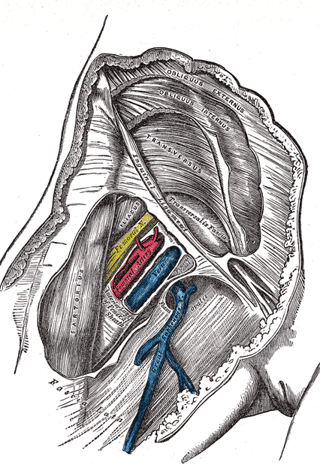
Osteoarthritis of The Hip
JOSPT Guideline for Mild to Moderate Hip Osteoarthritis
Clinicians should use manual therapy for patients with mild to moderate hip osteoarthritis and impairment of joint mobility, flexibility, and/or pain. ... As hip motion improves, clinicians should add exercises including stretching and strengthening to augment and sustain gains in the patient’s range of motion, flexibility, and strength.”
Hip Arthroplasty
A paper published in the journal PM&R, looked at the use of fascial manipulation following total hip arthroplasty. In this study two treatment sessions significantly improve functional outcomes in patients compared to usual treatment (Busato et al. 2016).
Low back was found to have a negative impact on postoperative improvement (Loth et al. 2017)
Cibulka et al. 2017. Hip Pain and Mobility Deficits— Hip Osteoarthritis: Revision 2017. J Orthop Sports Phys Ther.
Loth et al. (2017). Impact of Comorbidities on Outcome After Total Hip Arthroplasty. J Arthroplasty.
Busato et al. (2016). Fascial Manipulation Associated With Standard Care Compared to Only Standard Postsurgical Care for Total Hip Arthroplasty: A Randomized Controlled Trial. PM R.

Slide 49
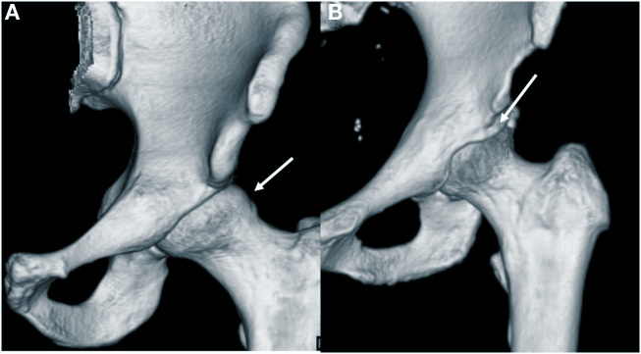
Femoral Acetabular Impingement - when the femoral head rubs abnormally or does not permit a normal range of motion in the acetabular socket, three types of FAI are:
Pincer. (Predominantly younger adult females) - This type of impingement occurs because extra bone extends out over the normal rim of the acetabulum.
Cam. (Predominantly younger adult males) - In cam impingement the femoral head is not round and cannot rotate smoothly inside the acetabulum.
Combined. (Predominantly younger adult males) Combined impingement just means that both the pincer and cam types are present.
From (Kuhns et al. 2015 - cam (A) and pincer (B) deformities.)
Notes:
(Clohisy et al. 2013 Nepple et al. 2015).

Slide 50
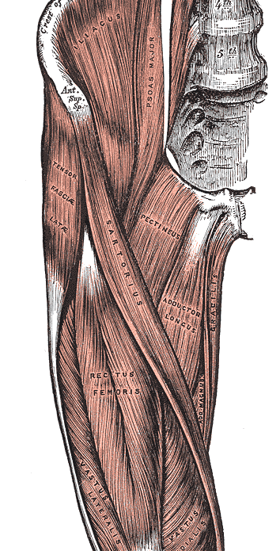
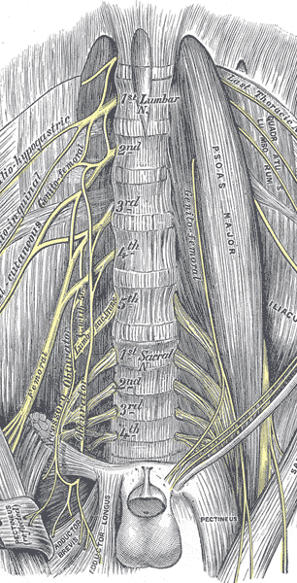
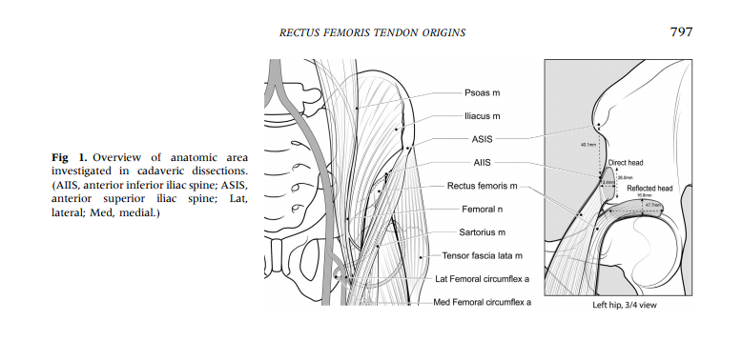
Beyond FAI & Labral Tear
Iliopsoas Tendinopathy
Rectus Femoris Proximal Tendinopathy
Pectineus
Nerve Irritations
Ryan et al. (2014). Origin of the direct and reflected head of the rectus femoris: an anatomic study. Arthroscopy.
Notes:
Ryan JM, Harris JD, Graham WC, Virk SS, Ellis TJ. Origin of the direct and reflected head of the rectus femoris: an anatomic study. Arthroscopy. 2014
Jul;30(7):796-802.
https://www.ncbi.nlm.nih.gov/pubmed/24793210

Slide 51
Sports Related Groin Pain
Osteitis pubis (inflammation of the pubis symphysis) - Can include loss of flexibility in the groin region, dull aching pain in the groin, or in more severe cases, a sharp stabbing pain when running, kicking, changing directions, or standing up or getting out of a car. Tenderness on palpation is also commonly present in the adductor longus origin.
Pudendal Neuralgia - Irritation of the pudendal nerve (Alcock’s canal), pain is positional and is worsened by sitting.
Sports Hernia/Athletic Pubalgia - Football and ice hockey players are affected most frequently. It is often clinical diagnosis of exclusion, with a history of chronic groin pain that is nonresponsive to treatment. Symptoms of athletic pubalgia are characterized by pain during sports movements—particularly, twisting and turning during single-limb stance. This pain usually radiates to the adductor muscle region and origin and to the testicles, often difficult for the patient to pinpoint (Tyler 2010).
Range of Motion Assessment
During preseason medical screening, examiners performed a hip-specific exam for four hundred thirty (299 male, 131 female) freshman athletes reporting no current or previous hip pain (Czuppon et al. 2017).
Male athletes generally demonstrated less hip ROM than female athletes
A positive FADIR was common
Hip ROM assessment does not allow correct identification of an athlete at risk of groin pain (Tak et al. 2017).
Tak et al. (2017). Is lower hip range of motion a risk factor for groin pain in athletes? A systematic review with clinical applications. Br J Sports Med.
Czuppon et al. (2017). Gender-Dependent Differences in Hip Range of Motion and Impingement Testing in Asymptomatic College Freshman Athletes. Pm&r.
Notes:
Czuppon, S., Prather, H., Hunt, D. M., Steger-May, K., Bloom, N. J., Clohisy, J. C., . . . Harris-Hayes, M. (2017). Gender-Dependent Differences in Hip Range of Motion and Impingement Testing in Asymptomatic College Freshman Athletes. Pm&r.
https://www.ncbi.nlm.nih.gov/pubmed/27840297
Tak, I., Engelaar, L., Gouttebarge, V., ... Weir, A. (2017). Is lower hip range of motion a risk factor for groin pain in athletes? A systematic review with clinical applications. Br J Sports Med.
https://www.ncbi.nlm.nih.gov/pubmed/28432076

Slide 52
Tools to Preserve & Improve Movement: Hamstrings
Preliminary findings suggest nordic hamstring exercises stimulate architectural adaptation and ↓ hamstring strains (Sugiura et al. 2017)
Changes in the passive elastic properties of human skeletal muscle can be induced by stretch training may have clinical implications for injury prevention and rehabilitation programs. ROM is due to both increases in stretch tolerance AND changes in passive properties of muscle.
8 weeks of high-intensity stretch training on biceps femoris (Freitas et al. 2015)
Nordic Hamstring Extension (Alonso-Fernandez et al. 2017, Bourne et al. 2017)
Bourne et al (2017). Impact of the Nordic hamstring and hip extension exercises on hamstring architecture and morphology: implications for injury prevention. Br J Sports Med.
Alonso-Fernandez et al. (2017). Changes in muscle architecture of Biceps Femoris induced by eccentric strength training with Nordic Hamstring Exercise. Scand J Med Sci Sports.
Notes:
Sugiura Y, Sakuma K, Sakuraba K, Sato Y. (2017). Prevention of Hamstring Injuries in Collegiate Sprinters. Orthop J Sports Med.
https://www.ncbi.nlm.nih.gov/pubmed/28210652
Alonso-Fernandez, D., Docampo-Blanco, P., Martinez-Fernandez, J. (2017). Changes in muscle architecture of Biceps Femoris induced by eccentric strength training with Nordic Hamstring Exercise. Scand J Med Sci Sports.
https://www.ncbi.nlm.nih.gov/pubmed/28314091
Bourne, M.N., Duhig, S.J., ... Shield, A.J. (2017). Impact of the Nordic hamstring and hip extension exercises on hamstring architecture and morphology: implications for injury prevention. Br J Sports Med, 51(5):469-477.
https://www.ncbi.nlm.nih.gov/pubmed/27660368
Freitas, S.R., Mil-Homens, P. (2015). Effect of 8-week high-intensity stretching training on biceps femoris architecture. J Strength Cond Res, 29(6):1737-40.
https://www.ncbi.nlm.nih.gov/pubmed/25486299
Simpson, C.L., Kim, B.D., Bourcet, M.R., Jones, G.R., Jakobi, J.M. (2017). Stretch training induces unequal adaptation in muscle fascicles and thickness in medial and lateral gastrocnemii. Scand J Med Sci Sports.
https://www.ncbi.nlm.nih.gov/pubmed/28138986

Slide 53
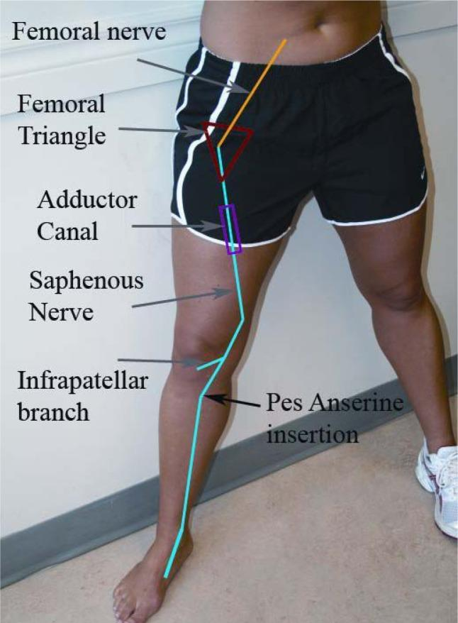
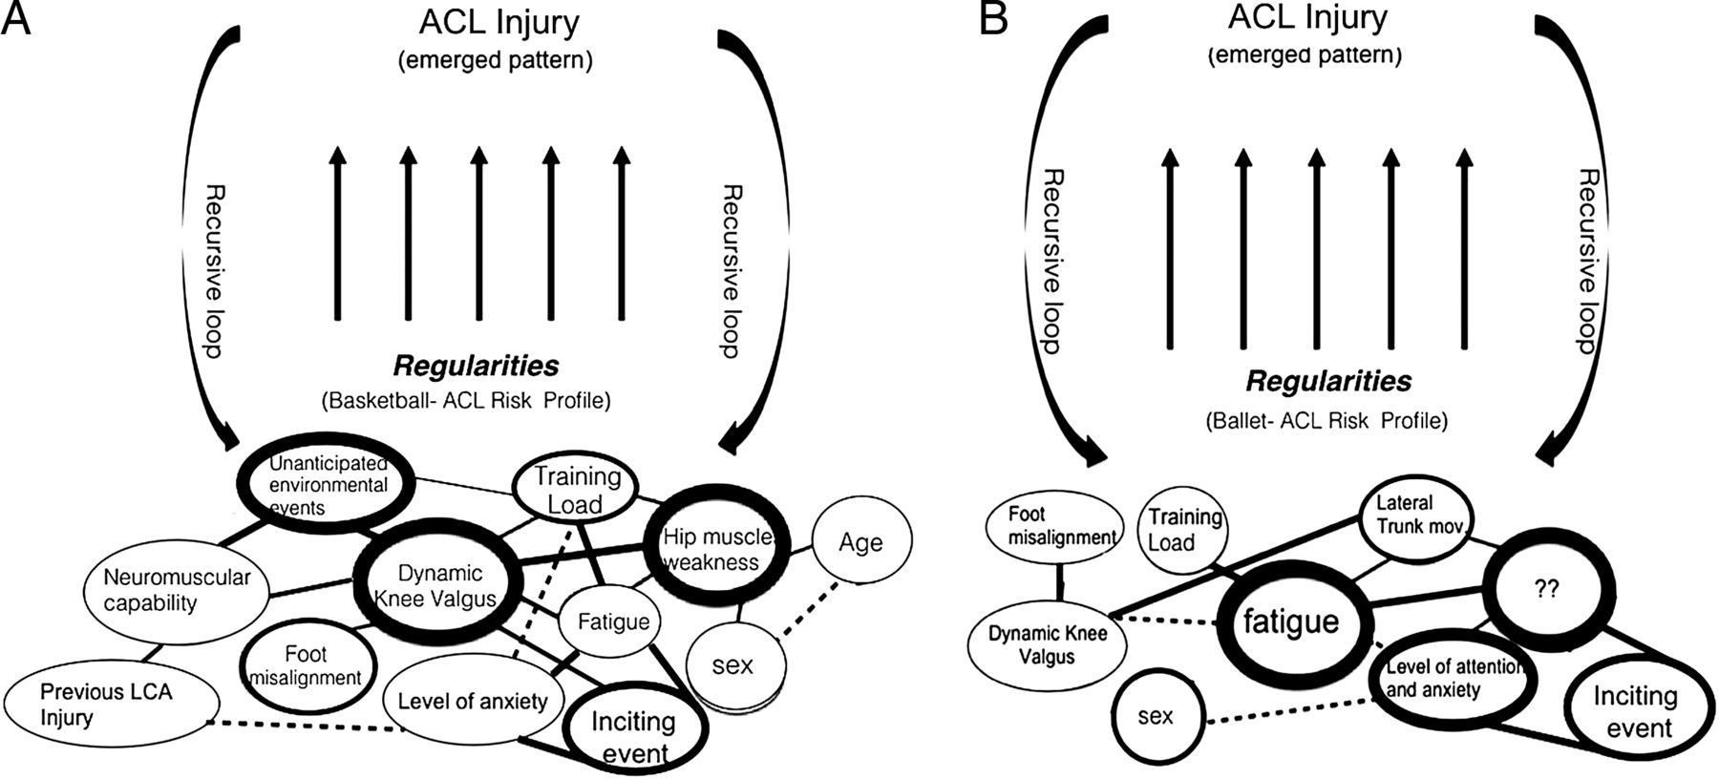
ACL
Postoperative Considerations:
Infrapatellar branch of saphenous nerve as differential for anterior knee pain.
Injury Pattern Recognition- Risk of ACL injury has been shown to be associated with:
Poor neuromotor control (Sugimoto et al. 2016)
Restricted hip internal rotation (VandenBerg et al. 2017)
Bittencourt et al. (2017). Complex systems approach for sports injuries: moving from risk factor identification to injury pattern recognition—narrative review and new concept. Br J Sports Med.
Porr et al. (2013). Entrapment of the saphenous nerve at the adductor canal affecting the infrapatellar branch - a report on two cases. J Can Chiropr Assoc.
Notes:
Porr, J., Chrobak, K., Muir, B. Entrapment of the saphenous nerve at the adductor canal affecting the infrapatellar branch - a report on two cases. J Can Chiropr Assoc.
Sugimoto et al. (2016). Critical components of neuromuscular training to reduce ACL injury risk in female athletesBritish Journal of Sports Medicine.
VandenBerg et al. (2017). Restricted Hip Rotation Is Correlated With an Increased Risk for AnteriorCruciate Ligament Injury. Arthroscopy.
LaPrade, R.F., Morgan, P.M., Wentorf, F.A., Johansen, S., Engebretsen, L. (2007). The anatomy of the posterior aspect of the knee. An anatomic study. J Bone Joint Surg Am, 89(4):758-64.
https://www.ncbi.nlm.nih.gov/pubmed/17403797
VandenBerg, C., Crawford, E.A., Sibilsky Enselman, E., Robbins, C.B., Wojtys, E.M., Bedi, A. (2017). Restricted Hip Rotation Is Correlated With an Increased Risk for Anterior Cruciate Ligament Injury. Arthroscopy.
https://www.ncbi.nlm.nih.gov/pubmed/27840056
Sugimoto, D., Myer, G. D., Foss, K. D., Pepin, M. J., Micheli, L. J., & Hewett, T. E. (2016). Critical components of neuromuscular training to reduce ACL injury risk in female athletes: Meta-regression analysis. British Journal of Sports Medicine.
https://www.ncbi.nlm.nih.gov/pubmed/27251898
Sugimoto, D., Myer, G.D., Foss, K.D., Hewett, T.E. (2015). Specific exercise effects of preventive neuromuscular training intervention on anterior cruciate ligament injury risk reduction in young females: meta-analysis and subgroup analysis. Br J Sports Med, 49(5):282-9.
https://www.ncbi.nlm.nih.gov/pubmed/25452612

Slide 54
Knee: Postoperative Management
The management of fibrosis depends on its staging
Fibrosis is a potential complication of trauma- characterized by excessive fibrous scar tissue.
Understanding the signaling pathways that drives the accumulation of fibrotic deposition, helps therapists optimize treatment protocols and guide prophylactic interventions.
The etiology of post surgical fibrosis is multifactorial
In the normal wound healing response, the cascade of biological responses is tightly regulated. The migration of inflammatory cells and the proliferation of fibroblasts trigger the release of cytokines and growth factors that are responsible for tissue remodeling. The development of fibrosis is characterized persistent transforming growth factor-β (TGF-β) secretion and downstream responses are thought to contribute to a sustained inflammatory response.
The neutralization of TGF-β1 expression could inhibit formation of excessive scar tissue
Massage therapy may improve healing after trauma and in some cases ameliorate the degree of postoperative fibrosis and adhesion formation. A study published in The Journal of Knee Surgery looked at the effect that soft-tissue treatments with hand-held instruments have on post-surgical knee stiffness. In the study soft-tissue treatments was shown to improve knee flexion deficits by 35° and knee flexion contractures by 12° in a cohort of individuals who had failed to respond to traditional rehabilitation and manipulation under anesthesia (Chunghtai et al. 2016).
Chughtai et al. (2016). A Novel, Nonoperative Treatment Demonstrates Success for Stiff Total Knee Arthroplasty after Failure of Conventional Therapy. J Knee Surg.
Notes:
Cheuy, V.A., Foran, J.R., Paxton, R.J., Bade, M.J., Zeni, J.A., Stevens-Lapsley, J.E. (2017). Arthrofibrosis Associated With Total Knee Arthroplasty. J Arthroplasty.
https://www.ncbi.nlm.nih.gov/pubmed/28285897
Kalson, N.S., Borthwick, L.A., Mann, D.A. ...Krenn, V. (2016). International consensus on the definition and classification of fibrosis of the knee joint. Bone Joint J, 98-B(11):1479-1488.
https://www.ncbi.nlm.nih.gov/pubmed/27803223
Chughtai, M., Mont, M.A., Cherian, C., Cherian, J.J., Elmallah, R.D., Naziri, Q., Harwin, S.F., Bhave, A. (2016). A Novel, Nonoperative Treatment Demonstrates Success for Stiff Total Knee Arthroplasty after Failure of Conventional Therapy. J Knee Surg, 29(3):188-93.
https://www.ncbi.nlm.nih.gov/pubmed/26713596

Slide 55
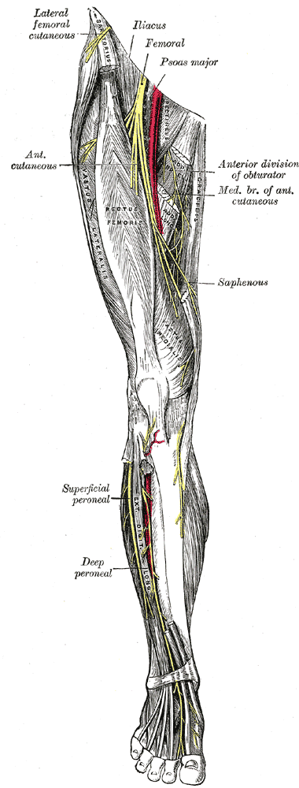
Osteoarthritis of The Knee
Joint Mobilization
Sensitisation of nociceptive pathways may result in patients with OA perceiving relatively low level stimuli as being overtly painful.
Manual therapy specifically oscillatory joint mobilization has an effect on supraspinal processes which influence nociceptive processing and therefore OA-related pain (Courtney et al. 2016).
Acupuncture
Needle insertion stimulates mechanoreceptors, which creates a number reflex effects resulting in reduced pain.
  Option for patients on multi-medications
  Research is encouraging (Level 1 Evidence - Journal of Bone and Joint Surgery)
  Clinically significant improvements in primary measures of pain
*Degenerative meniscus and OA is common, in the general population
Siemieniuk et al. (2017). Arthroscopic surgery for degenerative knee arthritis and meniscal tears: a clinical practice guideline. BMJ.
Courtney et al. (2016). Joint Mobilization Enhances Mechanisms of Conditioned Pain Modulation in Individuals With Osteoarthritis of the Knee. JOSPT.

Slide 56
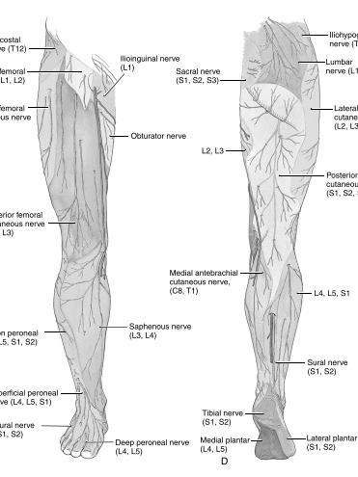
Patellofemoral Pain Syndrome
Neuromuscular Exercises
Abductor and external rotator muscle groups
Range of Motion
Hip ROM and ankle dorsiflexion should be considered in a rehabilitation program for physically active individuals (Malliaras et al. 2006)
Taping
Femoral rotational taping has been shown to be helpful for patellofemoral pain (Song et al. 2017)
Nerve Mobilization
Positive femoral slump test and a bilateral difference in hip extension angles to assess whether or not patients might benefit from femoral nerve mobilization (Huang et al. 2015).
Thomson et al. (2016). The outcome of hip exercise in patellofemoral pain: A systematic review. Man Ther.
Notes:
Huang, B.Y., Shih, Y.F., Chen, W.Y., Ma, H.L. (2015). Predictors for identifying patients with patellofemoral pain syndrome responding to femoral nerve mobilization. Arch Phys Med Rehabil, 96(5):920-7.
https://www.ncbi.nlm.nih.gov/pubmed/25576086
Thomson C, Krouwel O, Kuisma R, Hebron C. The outcome of hip exercise in patellofemoral pain: A systematic review. Man Ther. 2016 Dec;26:1-30.
https://www.ncbi.nlm.nih.gov/pubmed/27428378

Slide 57
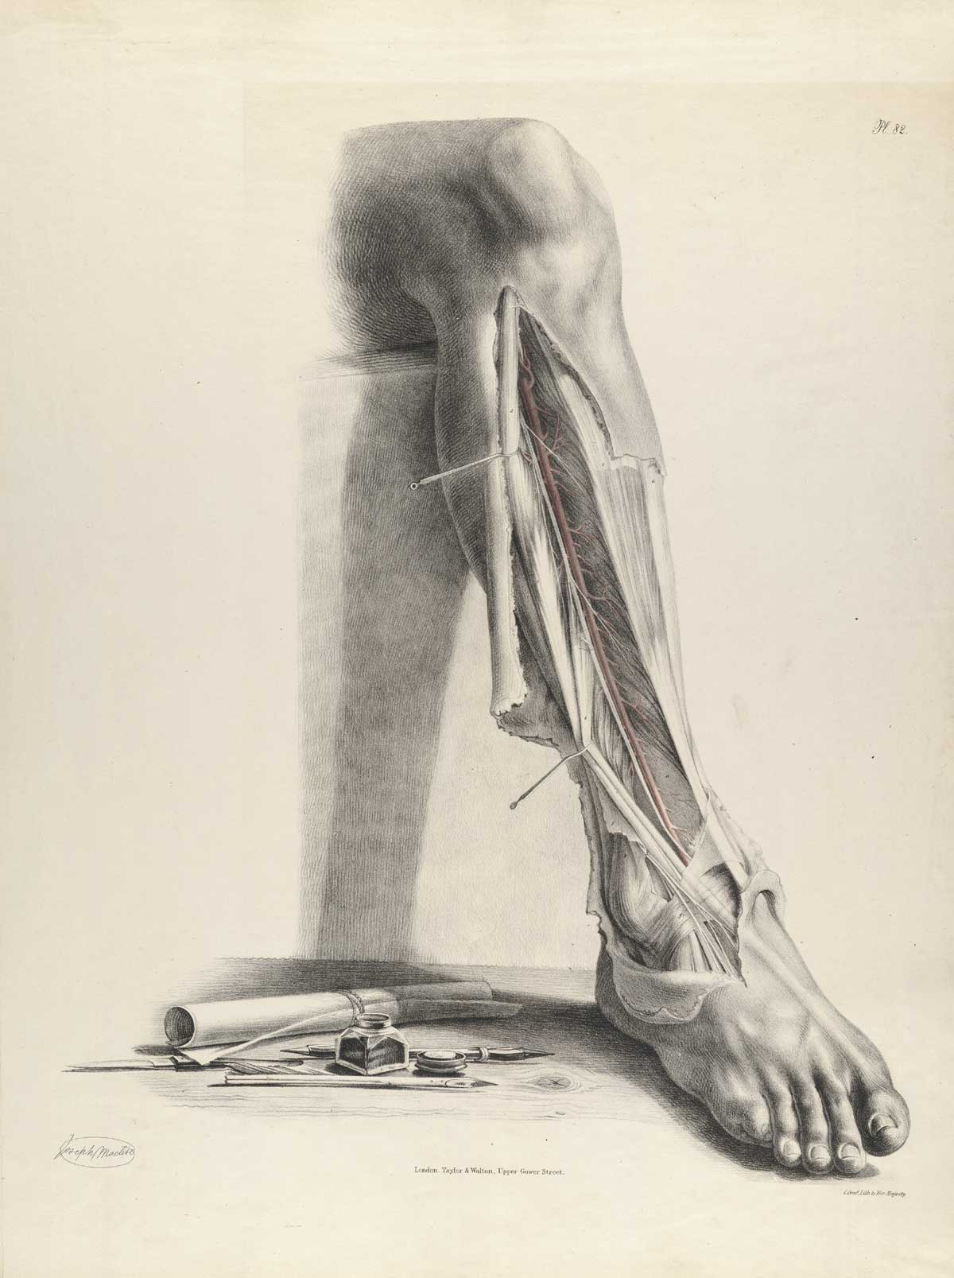
Medial Tibial Stress Syndrome
Management Strategies
  Lowering BMI
  Improving plantarflexion range of motion and
  Improving hip external rotation
  Flexor digitorum longus and tibialis posterior stiffness could be related (Saeki et al. 2017).
Chronic Exertional Compartment Syndrome
An exercise-induced condition that causes pain, swelling and in severe cases associated numbness.
Common to occur in runners - Rest and conservative interventions usually allow symptoms to resolve.
Rare that athletes require surgical interventions to manage their symptoms, however in these cases massage therapists can contribute to post-surgical rehabilitation programs (Flautt et al. 2013 & Schubert 2011).
Hamstra-Wright et al. (2015). Risk factors for medial tibial stress
syndrome in physically active individuals such as runners and military personnel: a systematic review and meta-analysis. Br J Sports Med.
Saeki et al. (2017). Muscle stiffness of posterior lower leg in runners with a history of medial tibial stress syndrome. Scand J Med Sci Sports.
Notes:
Saeki J, Nakamura M, Nakao S, Fujita K, Yanase K, Ichihashi N. (2017). Muscle stiffness of posterior lower leg in runners with a history of medial tibial stress syndrome. Scand J Med Sci Sports.
https://www.ncbi.nlm.nih.gov/pubmed/28207961

Slide 58
Tools to Preserve & Improve Movement: Ankle
The movements you do and the lifestyle you choose influences the form that tissue takes, stretch training is a viable modality to stimulate architectural adaptation.
6 weeks of loaded stretch training of the plantar flexors resulted in hypertrophic like adaptations of the gastrocnemius (Simpson et al. 2017)
3 wk of twice daily stretch training (4 × 30 s) lead to an increase in dorsiflexion range of motion and a 28% increase in passive joint moment (Blazevich et al. 2014)
4-week static stretch training program changes the flexibility of the gastrocnemius muscle tendon unit (Nakamura et al. 2012)
Notes:
Decrease in ankle mobility (Chimenti et al. 2016, Hamstra-Wright et al. 2015, Malliaras et al. 2006)
Rompe, J.D., Furia, J.P., Maffulli, N. (2008). Mid-portion Achilles tendinopathy--current options for treatment. Disabil Rehabil, 30(20-22):1666-76.
https://www.ncbi.nlm.nih.gov/pubmed/18608388
Nakamura, M., Ikezoe, T., Takeno, Y., Ichihashi, N. (2012). Effects of a 4-week static stretch training program on passive stiffness of human gastrocnemius muscle-tendon unit in vivo. Eur J Appl Physiol, 112(7):2749-55.
https://www.ncbi.nlm.nih.gov/pubmed/22124523
Simpson, C.L., Kim, B.D., Bourcet, M.R., Jones, G.R., Jakobi, J.M. (2017). Stretch training induces unequal adaptation in muscle fascicles and thickness in medial and lateral gastrocnemii. Scand J Med Sci Sports.
https://www.ncbi.nlm.nih.gov/pubmed/28138986

Slide 59

Achilles Tendon: Load it!
Achilles tendinopathy is categorised into two types:
Insertional (20–25%)
Non-insertional (75–80%)
Structured Loading Programs
Structural degeneration and pathological tendon take time to change, however achilles tendon appears to be capable of increasing its stiffness in response to 14 weeks of mechanical loading exercise (Epro et al. 2017).
*Eccentric exercise may not be as helpful for insertional tendon problems as compared to mid-portion dysfunction
Neuromuscular Buffering
Improved "buffering" of the tendon by the neuromuscular system (Debenham et al. 2017).
Symptom Modification
Nociceptive processing associated with tissue damage is modifiable in such a way that the pain subsides.
McCormack et al. (2016). Eccentric Exercise Versus Eccentric Exercise and Soft Tissue Treatment (Astym) in the Management of Insertional Achilles Tendinopathy. Sports Health.
Notes:
A 22% exercise-related improvement in ankle plantarflexion, along with increased AT stiffness and about 6% hypertrophy along the entire AT were identified after 14 weeks of strength training (Epro et al. 2017).
Magnussen RA, Dunn WR, Thomson AB (2009) Nonoperative treatment of midportion achilles tendinopathy: a systematic review. Clin J Sport Med 19(1):54–64
https://www.ncbi.nlm.nih.gov/pubmed/19124985
Debenham, J.R., Gibson, W.I., Travers, M.J., Campbell, A.C., Allison, G.T. (2017). Modulation of Stretch-Shortening-Cycle Behavior With Eccentric Loading of Triceps Surae: A Possible Therapeutic Mechanism. J Sport Rehabil.
https://www.ncbi.nlm.nih.gov/pubmed/27632850
O'Neill, S., Watson, P.J., Barry, S. (2015). Why are eccentric exercises effective for achilles tendinopathy? Int J Sports Phys Ther.
McCormack, J.R., Underwood, F.B., Slaven, E.J., Cappaert, T.A. (2016). Eccentric Exercise Versus Eccentric Exercise and Soft Tissue Treatment (Astym) in the Management of Insertional Achilles Tendinopathy. Sports Health.
Epro, G., Mierau, A., ... Karamanidis, K. (2017). The Achilles tendon is mechanosensitive in older adults: adaptations following 14 weeks versus 1.5 years of cyclic strain exercise. J Exp Biol.
https://www.ncbi.nlm.nih.gov/pubmed/28298464

Slide 60
Tarsal Tunnel Syndrome
Tibialis posterior
Flexor digitorum longus
Flexor hallucis longus
Nerve Mobilization: Tarsal Tunnel Syndrome
Nerve mobilization may be be useful for athletes (Kavlak et al. 2011).
Slump position with ankle dorsiflexion and eversion
Ankle Sprain
Following initial injury there is a risk of re-injury, this is dependent on a combination of factors, including: sensorimotor deficits and changes in ankle biomechanics.
Manual Therapy and Joint Mobilization
“moderate evidence supporting exercise and manual therapy techniques, for pain, swelling and function.” (Doherty et al. 2017)
“A protocol involving proprioceptive and strengthening exercises and manual therapy (mobilizations to influence joint and nerve structures) resulted in greater improvements in pain, self-reported functional joint stability, strength and ROM compared to exercises alone.” (Plaza-Manzano et al. 2016)
Plantar Massage
Plantar massage & joint mobilization enhance motor control in patients (Mckeon et al. 2016)
Nerve Mobilization: Ankle Sprain
Plantar flexion + Inversion + SLR is used to mobilize the superficial peroneal nerve (Plaza-Manzano 2016)
Notes:
Kavlak, Y., Uygur, F. (2011). Effects of nerve mobilization exercise as an adjunct to the conservative treatment for patients with tarsal tunnel syndrome. J Manipulative Physiol Ther, 34(7):441-8.
https://www.ncbi.nlm.nih.gov/pubmed/21875518

Slide 61

Plantar heel pain generally described as sharp or stabbing, and worse in the morning. The pain can decrease with activity, but can return after long periods of standing or after getting up from a seated position.
Evidence that joint mobilisation, calf massage stretching and eccentric loading helpful in improving function and reducing plantar heel pain (Piper et al. 2016, Sutton et al. 2016).
Calf Massage and Stretches
Tightness in the calf muscles and reduced dorsiflexion are a possible factor for plantar heel pain (Bolivar 2013, Pascual Huerta 2014, Patel & DiGiovanni 2011).
Friction massage, in combination with stretching has is thought to restore tissue elasticity and reduce the strain in the muscle-tendon unit. (Joseph et al. 2012).
Hamstrings
Hamstring tightness may play a role in plantar heel pain (Bolívar et al. 2013, Harty et al 2005, Labovitz et al. 2011)
Nerve Mobilization
Saphenous nerve - branch of femoral nerve, it provides cutaneous innervation to medial portions of the leg, ankle and foot.
Sural nerve Possible involvement of the sural nerve as it passes through the superficial sural aponeurosis (Fabre et al. 2000). Sensory branch of tibial n. that innervates the lateral part of the leg and foot.
  Sural nerve pathology can be caused by to fascial thickening, local scar tissue due to an inversion ankle sprain or surgical trauma (Paraskevas et al 2014) - SLR + dorsiflexion and inversion
Notes:
Paraskevas, G., Natsis, K., Tzika, M., & Ioannidis, O. (2014). Fascial entrapment of the sural nerve and its clinical relevance. Anatomy & Cell Biology.
Pomeroy, G., Wilton, J., Anthony, S. (2015). Entrapment neuropathy about the foot and ankle: an update. J Am Acad Orthop Surg.
https://www.ncbi.nlm.nih.gov/pubmed/25538131
Fabre T, Montero C, Gaujard E, Gervais-Dellion F, Durandeau A. Chronic calf pain in athletes due to sural nerve entrapment. A report of 18 cases. Am J Sports Med. 2000
https://www.ncbi.nlm.nih.gov/pubmed/11032224
Begovic, H., Zhou, G., Schuster, S., & Zheng, Y. (2016). The neuromotor effects of transverse friction massage. Manual Therapy.
https://www.ncbi.nlm.nih.gov/pubmed/27497646

Slide 62


The Foot Core
The neural, active and passive subsystems interact to produce the foot core system which provides stability and flexibility to cope with changing foot demands.
Apply a light dorsiflexion stretch of the great toe, other toes and related fascia, followed up by oscillating mobilization of metatarsals and interossei.
Apply soft tissue therapy or petrissage especially to the plantar muscles and to tender points in gastrocnemius, soleus, adductor hallucis, flexor hallucis brevis
McKeon et al. (2015) The foot core system: a new paradigm for understanding intrinsic foot muscle function. Br J Sports Med.
Notes:
Useful for achilles tendon pain, functional hallux rigidus and plantar heel pain
McKeon PO, Hertel J, Bramble D, Davis I. (2015) The foot core system: a new paradigm for understanding intrinsic foot muscle function. Br J Sports Med.
https://www.ncbi.nlm.nih.gov/pubmed/24659509

Slide 63

The Soothing Ritual of Self-Care
The human body is constantly remodeling itself in response to intrinsic and extrinsic input. Some adaptive mechanisms operate instantaneously, others take effect over months or years.
Post-treatment movement practices stimulate positive neurological adaptations & preserve the stabilizing role of connective tissue.
Resiliency & Athletic Development
90-90 Hip Rotations
Toe Sitting
Deep Squat
Shoulder Protocol
Relevance of stretch intensity and position
Four stretch parameters that have been identified as being important for potentially influencing the increase or decrease of flexibility of a joint:
Intensity
Duration
Frequency
Position
Apostolopoulos et al. (2015). The relevance of stretch intensity and position-a systematic review. Front Psychol.

Slide 64
Field Notes: Treatment
“Our practice is really very simple, even though it takes many years of dedicated practice and study to actually make it simple.”
-Dr. Alejandro Elorriaga Claraco
Biopsychosocial Framework - Massage therapists are professionally trained to treat active individuals, they specialize in a clinically-oriented approach that helps alleviate the musculoskeletal disorders associated with everyday stress, physical manifestation of mental distress, muscular overuse and many persistent pain syndromes.
Responses are Multifactorial - Clinical considerations, such as optimal timing of treatment and mechanism of action are important considerations in weighing the choice between duration and treatments approach.
Contextual Aided Recovery - What you say to an injured athlete can change their perception of their injury- for better or worse.
Pain Neuroscience Education - communicating to patients that biological, psychological (i.e. thoughts, emotions, and behaviors) and social (i.e. work and culture) factors play a significant role in the experience and reduction of pain (Louw et al. 2016).
Louw et al. (2016). The efficacy of pain neuroscience education on musculoskeletal pain: A systematic review of the literature. Journal Physiotherapy Theory and Practice.

Slide 65

Field Notes: The Assessment Process
Person-centred approach - An individualized examination based on patient presentation, goals and preferences.
Multidimensional patient profiles - Assessment of sports injuries based on subjective information (patient history) and objective information (i.e., observation and inspection, palpation, and special testing) to recognize and identify issues contributing to the condition.
  History
  Observation
  Palpation
  Special Testing
Special tests are good at reproducing pain but not great at telling us where the symptoms are coming from (Hegedus et al. 2017).
Hegedus et al. (2017). Orthopaedic special tests and diagnostic accuracy studies: house wine served in very cheap containers. Br J Sports Med.
“There are no secrets, there is only understanding, and a lengthy process of refinement of this understanding.”
-Dr. Alejandro Elorriaga Claraco

Slide 66
Take Home- Massage therapy is a non-pharmacological therapeutic intervention that is simple to carry out, economical, and has very few side effects.
Biological and psychosocial therapeutic mechanisms interplay in a complex manner
Create a safe, positive therapeutic environment - Sometimes irrespective of treatment approach, simply engaging with the patient has the potential to reduce the impact of pain and improve quality of life.
Empathise, address expectations & educate to enhance outcomes - Contribute to positive outcomes by: building confidence and compliance, providing reassurance and rehabilitation consistent with the complex, multidimensional nature of sport injuries.
Registered Massage Therapists have many ‘tools’ at their disposal (ie. manual therapy, patient education, acupuncture, IASTM and cupping). Clinical reason for what ‘tool’ to use involve: Patient Values, Clinician Experience and Best Available Evidence

Slide 67
THANK YOU
Contact Information
Richard Lebert
Twitter @Adaptivetherapy
Facebook.com/Adaptivetherapy

Slide 68
Ancillary Materials
Body of Evidence
Further Reading & Sources
SCAT5 & Pocket Concussion Recognition Tool
Signs of a Concussion - Holland Bloorview
Cholok et al. (2017). Traumatic muscle fibrosis: From pathway to prevention. J Trauma Acute Care Surg.
Thompson et al. (2016). Understanding Mechanobiology: Physical Therapists as a Force in Mechanotherapy and Musculoskeletal Regenerative Rehabilitation. Physical Therapy.

Slide 69
The Body Of Evidence is GROWING!
Recent recommendations from Canadian Medical Association, The American College of Physicians, Ontario Protocol for Traffic Injury Management (OPTIMa) and The Mayo Clinic represent a monumental shift in pain management represent a monumental shift in pain management.
Physicians, now more than ever, are recommending conservative evidence based treatment including massage, acupuncture and exercise as part of a multi-modal approach for patients suffering from low back pain, headaches, anxiety and stress.
We offer a unique a patient-centred approach that addresses the biopsychosocial influences and empowers patients to actively self-manage aches and pains, including but not limited to:
Back pain (Chou et al. 2017, Busse et al. 2017, Qaseem et al. 2017, Nahin et al. 2016, Wong et al. 2017)
Neck pain (Bussières et al. 2016, Busse et al. 2017, Côté et al. 2016, Nahin et al. 2016, Sutton et al. 2016, Wong et al. 2016)
Temporomandibular joint disorder (Martins et al. 2016, Randhawa et al. 2016)
Tension Headaches (Busse et al. 2017, Chaibi et al. 2014, Nahin et al. 2016, Varatharajan et al. 2016)
Carpal Tunnel Syndrome (Piper et al. 2016, Huisstede et al 2017)
Lateral Epicondylitis (Piper et al. 2016, Sutton et al. 2016)
Hip Osteoarthritis (Cibulka et al. 2017)
Medial tibial stress syndrome (Rajasekaran et al. 2016)
Knee Osteoarthritis (Busse et al. 2017, Salamh et al. 2017, Xu et al. 2017)
Ankle Sprains (Doherty et al. 2017)
Plantar Heel Pain (Piper et al. 2016, Sutton et al. 2016)

Slide 70
Further Reading & Sources
A selection of readings - books and articles that might be of interest if you want to explore the topics introduced here in more depth:
Technical Books
Functional Atlas of the Human Fascial System. Carla Stecco
Manual Therapy for Musculoskeletal Pain Syndromes. Cesar Fernandez de las Pen.
The Oxford Textbook of Musculoskeletal Medicine. Michael Hutson.
Brukner & Khan’s Clinical Sports Medicine Injuries.
Explain Pain Supercharged. Lorimer Moseley and David Butler
General Reference Books
Cure. Jo Marchant
The Brain That Changes Itself. Norman Doidge
The Story of the Human Body. Daniel Lieberman
Touch. David Linden
Understanding Pain. Fernando Cervero

Slide 71



Slide 72


Slide 73



Notes:
Cholok, D., Lee, E., Lisiecki, J., Agarwal, S., Loder, S., Ranganathan, K., Qureshi, A.T., Davis, T.A., Levi, B. (2017). Traumatic muscle fibrosis: From pathway to prevention. J Trauma Acute Care Surg.
https://www.ncbi.nlm.nih.gov/pubmed/27787441

Slide 74

Mechanotherapy
“Any intervention that introduces mechanical forces with the goal of altering molecular pathways and inducing a cellular response that enhances tissue growth, modeling, remodeling, or repair.”
“Mechanical forces direct cellular activities influencing the tissue-level processes of growth, modeling, remodeling, and repair, with the ultimate outcomes being altered tissue mass, structure, and quality (Fig. 1). Nearly every physical therapy intervention in musculoskeletal rehabilitation introduces mechanical forces, regardless of whether the forces are generated extrinsically via therapist intervention (eg, during joint or tissue mobilization or via the introduction of external therapeutic modalities) or intrinsically within the individual themselves via the prescription of exercise therapy.
Thompson et al. (2016). Understanding Mechanobiology: Physical Therapists as a Force in Mechanotherapy and Musculoskeletal Regenerative Rehabilitation. Physical Therapy.
Notes:
Thompson, W. R., Scott, A., Loghmani, M. T., Ward, S. R., & Warden, S. J. (2016). Understanding Mechanobiology: Physical Therapists as a Force in Mechanotherapy and Musculoskeletal Regenerative Rehabilitation. Physical Therapy. (Open Access)
https://www.ncbi.nlm.nih.gov/pubmed/26637643

Slide 75
Image Credit
Images From Wikimedia licensed under creative commons unless otherwise stated
Calf - By Dr. Johannes Sobotta - Atlas and Text-book of Human Anatomy Volume III Vascular System, Lymphatic system, Nervous system and Sense Organs, Public Domain, https://commons.wikimedia.org/w/index.php?curid=29135488
Calf - By Dr Johannes Sobotta - Sobotta's Atlas and Text-book of Human Anatomy 1909, Public Domain, https://commons.wikimedia.org/w/index.php?curid=29296803

